Slide 1
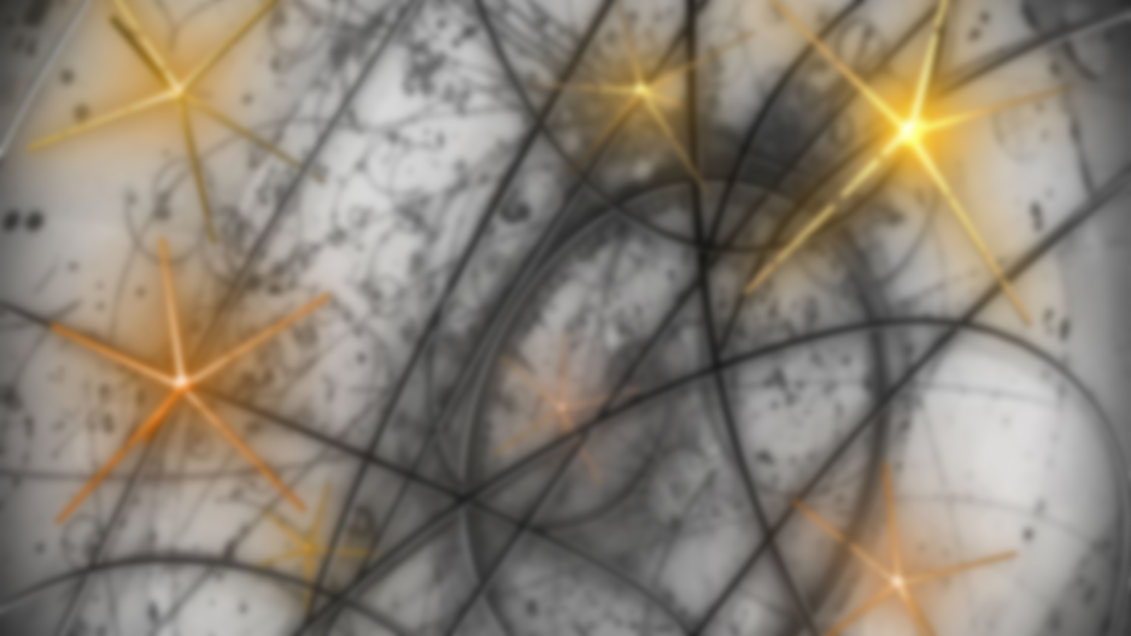
Field Theory and Electroweak Standard Model
(Three Lectures)
Faisal Akram
7th School on LHC Physics, August 6-17, 2018
NCP, Islamabad

Slide 2
Outlines
Introduction
Particle contents of the standard model
The main principle of its construction
Brief review of quantum field theoy
Lagrangian formalism of field theory
Connection between fields and particles
Lorentz and gauge symmetries
Gauge principle
Spontaneous symmetry breaking
Higgs mechanism
Derivation of the EW standard model Lagrangian
The Higgs sector of the EW standard model
Interactions of Lepton and quarks with gauge fields
Yukawa couplings and CKM matrix
The gauge sector
Phenomenology and precision tests of the EW standard model
Conclusion

Slide 3
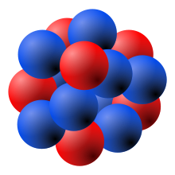
Elementary Particle Physics
What are the ultimate constituents of matter?
What are the laws of their interactions?
These ultimate constituents of matter
are called elementary particles.
Elementary particles: (electron, photon, neutrinos, etc)
Composite particles: (nucleus, proton, neutron, pions, etc)

Slide 4
Present status of Elementary Particle Physics
Elementary particles
Quarks Leptons Gauge Boson Higgs Boson
(can interact through (cannot interact through (mediate interactions) (impart mass to the elementary
strong interaction) strong interaction) particles)
$\left(\begin{matrix} u \\ d\end{matrix}\right) \left(\begin{matrix} c \\ s\end{matrix}\right)$ $\left(\begin{matrix} t \\ b\end{matrix}\right)$
Hadrons:
Meson: $s=0,1,2…$
Baryons: $s=\frac{1}{2},\frac{3}{2},…$
Quarks:
$\left(\begin{matrix}v_{e} \\ e\end{matrix}\right) \left(\begin{matrix}v_{μ} \\ μ\end{matrix}\right)$ $\left(\begin{matrix}v_{τ} \\ τ\end{matrix}\right)$
Meson:
Baryon
Leptons:
Gauge Bosons:
$γ, W^{±}, Z^{0},$ and 8 gluons
399 Mesons, 287 Baryons have been discovered
Higgs Bosons:
$H$ (Higgs particle)
Strong interaction
Electromagnetic interaction
Weak interactions
(Quantum chromodynamics)
The Standard Model
(The electroweak standard model)

Slide 5
How the standard model was discovered?
Scattering Experiments
Decay Processes
Study of bound states
Cross sections, Decay Constants,
Couplings, Form factors, Masses, Spin etc
Models
Particle Accelerators and detectors
Models
Experimental
Particle Physicist
Particle Physics
Phenomenologist
Theoretical Particle
Physicist
Measured values of
physical observables
$$≈$$
Calculated values of
physical observables
It doesn’t matter how beautiful your theory is,
It doesn’t matter how smart you are. If it doesn’t
agree with experiment, it’s wrong… R.P. Feynman
It is more important to have beauty
in one's equations than to have
them fit with experiments..... P.A.M Dirac
Decades of observations and calculations show that the Standard Model of particle physics
can describe almost every thing which we have observed in the labs of high energy physics.

Slide 6
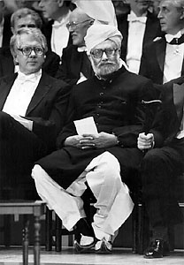
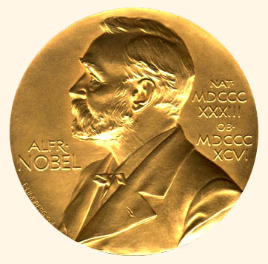
The Standard Model of Particles Physics:
Nobel Prize 1979
“Scientific thought and its creation is a common and shared heritage of mankind”
Salam in Ideals and Realities

Slide 7
Overview of the principles of the construction of EW standard model
The standard model is built within local quantum field theory.
i.e., $ℒ\left(φ_{r}(x),{∂_{μ}φ}_{r}(x)\right)$
It is based on two symmetries; Lorentz symmetry and a gauge symmetry.
Lorentz Transformation: $x^{′μ}=Λ_{ ν}^{μ}x^{ν}$ ($det\left(Λ\right)=1 \& Λ_{ 0}^{0}≥1$)
Global gauge transformation: $φ^{′}\left(x\right)=e^{iθ}φ(x)$
Local gauge transformation: $φ^{′}\left(x\right)=e^{iθ(x)}φ(x)$
Interactions of fermion with gauge boson are introduced when global symmetry is extended
into local symmetry (Gauge Principle).
The SM is a gauge theory based on the gauge symmetry ${SU(2)}_{L}×U(1)$.
The gauge symmetry ${SU(2)}_{L}×U(1)$ muct be broken spontaneously to impart mass to
the some gauge bosons (and fermions) in the SM.
The theory of interactions must be renormalizable to obtain finite predictions for observables.

Slide 8
A quick review of quantum field theory
A field theory is a physical theory which deals with a system of field(s).
State of the field is specified by field functions.
$φ_{r}\left(t,x\right),$ $r=1,2,3…n$
Time evolution of field functions is described by Euler’s Lagrange equations.
$$\frac{∂ℒ}{∂φ_{r}}−∂_{μ}\frac{∂ℒ}{∂\left(∂_{μ}φ_{r}\right)}=0$$
Where, $L=\int{d^{4}x ℒ(φ_{r},{∂_{μ}φ}_{r})}$

Slide 9
A quick review of quantum field theory
Notations:
$x^{μ}=\left(t,x\right), x_{μ}=(t,−x)$, $x^{μ}=g^{μν}x_{ν}$
$x^{μ}$ $x_{μ}=t^{2}−x^{2}−y^{2}+z^{2}$
$∂_{μ}=\frac{∂}{∂x^{μ}}$ $∂^{μ}=\frac{∂}{∂x_{μ}}$
$$g^{μν}=\left(\begin{matrix}1 & 0 & 0 & 0 \\ 0 & −1 & 0 & 0 \\ 0 & 0 & −1 & 0 \\ 0 & 0 & 0 & −1\end{matrix}\right)$$
Lorentz Transformation: $x^{′μ}=Λ_{ ν}^{μ}x^{ν}$ for which $x^{μ}$ $x_{μ}$ is invariant
Proper orthocronus LT
($det\left(Λ\right)=1 \& Λ_{ 0}^{0}≥1$)
$$x_{μ}^{′}={\left(Λ^{−1}\right)}_{ ν}^{μ}x_{ν}$$
Classification of fields:
Natural Units: $c=ℏ=1$
$\left[t\right]=\left[x\right]={GeV}^{−1},\left[E\right]=\left[m\right]=\left[p\right]={GeV}^{1}$
Lorentz invariance is implied if Lagrangian is built using these fields and their 4-derivative.
All it requires that in each term all Lorentz indices must be fully contracted.

Slide 10
A quick review of quantum field theory
In a field theory, fields act as fundamental d.o.f of the system rather than particles itself.
Particles appear as quanta of the corresponding field.
To every different kind of a particle we associate a field.
(e.g., electron field, proton field, photon field etc)
$$φ(x)$$
Quantization
Quanta of field has particle properties.
What kind of field is required to describe a particle of specific kind?

Slide 11
A quick review of quantum field theory
Equation of motions/Lagrangian of three kinds of field:
Free Scalar Field: ($s=0)$
$${(∂}_{μ}∂^{μ}+m^{2})φ(x)=0$$
$$ℒ_{0}=∂_{μ}φ^{†}∂^{μ}φ−m^{2}φ^{†}φ$$
Under Lorentz transformation $x^{′μ}=Λ_{ ν}^{μ}x^{ν}$
$$φ^{′}\left(x^{′}\right)=φ\left(x\right),$$
$A^{′μ}(x^{′})=Λ_{ ν}^{μ}A^{ν}(x)$.
Free Vector Field: ($s=1)$
$$∂_{μ}∂^{μ}A^{ν}+∂^{ν}{(∂}_{μ}A^{μ})=0$$
$$ℒ_{0}=−\frac{1}{4}F_{μν}F^{μν}$$
Where, $F_{μν}=∂_{μ}A_{ν}−∂_{ν}A_{μ}$

Slide 12
A quick review of quantum field theory
Free Dirac Field: ($s=1/2)$
$$\left\{γ^{μ},γ^{ν}\right\}=2g^{μν}$$
$$γ^{0}=\left(\begin{matrix}1 & 0 \\ 0 & −1\end{matrix}\right), γ^{i}=\left(\begin{matrix}0 & σ_{i} \\ −σ_{i} & 0\end{matrix}\right)$$
$γ^{5}≡iγ^{0}$ $γ^{1}$ $γ^{2}$ $γ^{3}$, $\left\{γ^{5},γ^{μ}\right\}=0$
$$\overline{ψ}=ψ^{†}γ^{0}$$
$$ψ=\left(\begin{matrix}ψ_{1} \\ ψ_{2} \\ ψ_{3} \\ ψ_{4}\end{matrix}\right)$$
$$\left(iγ^{μ}∂_{μ}−m\right)ψ(x)=0$$
$$ℒ_{0}=i\overline{ψ}γ^{μ}∂_{μ}ψ−m\overline{ψ}ψ$$
Lorentz invariance of $ℒ_{0}$ requires
Where, $S^{−1}γ^{μ}S=Λ_{ ν}^{μ}γ^{ν}$
Dirac field transforms under a representation of Lorentz group.

Slide 13
A quick review of quantum field theory
Interactions between the fields are introduced by the terms coupling 3 or more fields.
For example:
NO
NO
YES
YES
YES
YES
YES
YES
Only Lorentz invariant couplings are allowed.
$$φ^{′}\left(x^{′}\right)=φ\left(x\right),$$
$$A^{′μ}\left(x^{′}\right)=Λ_{ ν}^{μ}A^{ν}\left(x\right),$$
$ψ^{′}\left(x^{′}\right)=Sψ\left(x\right)$, ${\overline{ψ}}^{′}\left(x^{′}\right)=\overline{ψ}\left(x\right)S^{−1}$.
Dirac Bilinear covariants
One of the necessary conditions of renormalizability of a field
theory is that coupling constant g must be dimensionless.
(or having dimension >1 in this case theory is super
renormalizable)
Possible couplings are significantly reduced if $\left[g\right]≥0$.
Lorentz invariance is implied if we use bilinear covariants (if required) and contracting all
Lorentz indices.

Slide 14
A quick review of quantum field theory
Interaction between the fields is introduced by the terms coupling 3 or more fields.
For example:
NO NO YES YES YES YES YES YES
$$\left[g\right]=$$
1
0
-2
1
0
0
0
0
$$\left[ℒ\right]={GeV}^{4}≡4, \left[∂_{μ}\right]={GeV}^{1}≡1,$$
$$\left[ϕ\right]=\left[A_{μ}\right]=1$$
$$\left[ψ\right]=\left[\overline{ψ}\right]=3/2$$
Possible Lorentz invariant (LI) Couplings with $\left[g\right]=0$:
FFV FFS VVV VVVV SSSS
Possible LI Couplings with $\left[g\right]=1$
No LI Coupling with $\left[g\right]>1$

Slide 15
Field Theory and the Electroweak Standard Model
(Lecture 2)
Faisal Akram
7th School on LHC Physics, 6-18 August 2018
NCP, Islamabad.

Slide 16
Outlines
Introduction
Particle contents of the standard model
The main principle of its construction
Brief review of quantum field theoy
Lagrangian formalism of field theory
Connection between fields and particles
Lorentz and gauge symmetries
Gauge principle
Spontaneous symmetry breaking
Higgs mechanism
Derivation of the EW standard model Lagrangian
The Higgs sector of the EW standard model
Interactions of Lepton and quarks with gauge fields
Yukawa couplings and CKM matrix
The gauge sector
Phenomenology and precision tests of the EW standard model
Conclusion

Slide 17
Gauge Symmetry
1. Lagrangian of single massive free Dirac field:
$$ℒ_{0}=i\overline{ψ}γ^{μ}∂_{μ}ψ−m\overline{ψ}ψ$$
U(1) global gauge symmetry
U(1) global gauge transformation
$ψ^{′}\left(x\right)=e^{iθ}ψ\left(x\right)$, $\text{for} \text{all} θ∈[0, 2π]$
${\overline{ψ}}^{′}\left(x\right)=e^{−iθ}\overline{ψ}\left(x\right)$.
U(1) local gauge transformation
$$ψ^{′}\left(x\right)=e^{iθ(x)}ψ\left(x\right)$$
$ℒ_{0}$ in invariant under U(1) global gauge transformation but not under local gauge transformation.
(Global gauge transformation) $∂_{μ}ψ→∂_{μ}\left(e^{iθ}ψ\right)=e^{iθ}∂_{μ}ψ$
(Local gauge transformation) $∂_{μ}ψ→∂_{μ}\left(e^{iθ(x)}ψ\right)=e^{iθ}∂_{μ}ψ+i(∂_{μ}θ)e^{iθ}ψ$
How can we modify the above Lagrangian so that it has U(1) local gauge symmetry?

Slide 18
Gauge Symmetry
1. Lagrangian of single massive free Dirac field:
$$ℒ_{0}=i\overline{ψ}γ^{μ}∂_{μ}ψ−m\overline{ψ}ψ$$
U(1) global gauge symmetry
Such that
$$X=−ieA_{μ}$$
$$\overline{ψ}$$
$$A_{μ}$$
$$\left(∂_{μ}−ie{A^{′}}_{μ}\right)e^{\left.iθ(x\right)}ψ=e^{\left.iθ(x\right)}\left(∂_{μ}−ieA_{μ}\right)ψ$$
$$ψ$$
An important result:
$$ℒ =i\overline{ψ}γ^{μ}D_{μ}ψ−m\overline{ψ}ψ=i\overline{ψ}γ^{μ}\left(∂_{μ}−ieA_{μ}\right)ψ−m\overline{ψ}ψ$$
$$ℒ=i\overline{ψ}γ^{μ}∂_{μ}ψ−m\overline{ψ}ψ+e\overline{ψ}γ^{μ}ψA_{μ}$$
(Exercise)
$$ℒ=i\overline{ψ}γ^{μ}∂_{μ}ψ−m\overline{ψ}ψ+e\overline{ψ}γ^{μ}ψA_{μ}−\frac{1}{4}F_{μν}F^{μν}$$
Where, $F_{μν}=∂_{μ}A_{ν}−∂_{ν}A_{μ}$
$F_{μν}^{′}=F_{μν}$ (gauge invariant)
Complete Lagrangian having U(1) local gauge symmetry

Slide 19
Gauge Symmetry
2. Lagrangian of double massive free Dirac field:
$$ℒ_{0}=i{\overline{ψ}}_{1}γ^{μ}∂_{μ}ψ_{1}−m{\overline{ψ}}_{1}ψ_{1}+i{\overline{ψ}}_{2}γ^{μ}∂_{μ}ψ_{2}−m{\overline{ψ}}_{2}ψ_{2}$$
$$ℒ_{0}=i\overline{ψ}γ^{μ}∂_{μ}ψ−m\overline{ψ}ψ$$
Where $ψ=\left(\begin{matrix}ψ_{1} \\ ψ_{2}\end{matrix}\right)$.
A complex 2x2 unitary matrix
$$U^{†}U=I$$
A global unitary transformation: $ψ^{′}=Uψ$, ${\overline{ψ}}^{′}=\overline{ψ}U^{†}$
U(2) global gauge symmetry
Infinitesimal unitary transformation: $U\left(ε\right)=1+iε_{a}T_{a}$ $a=1,2,3,4$
Finite unitary transformation: $U\left(θ\right)=e^{iθ_{a}T_{a}}$
The generators of U(2) group:
Special unitary transformation: $U^{†}U=I$ and $det(U)=1$
Set of all 2x2 complex special unitary matrices define a subgroup
of U(2) group represented by SU(2).
Its generator are Pauli spin matrices.
$${[T}_{a},T_{b}]=iε_{abc}T_{c}$$

Slide 20
Gauge Symmetry
2. Lagrangian of double massive free Dirac field:
$$ℒ_{0}=i\overline{ψ}γ^{μ}∂_{μ}ψ−m\overline{ψ}ψ$$
U(2) or SU(2) global gauge symmetry
Such that
(Exercise)
$$ℒ =i\overline{ψ}γ^{μ}D_{μ}ψ−m\overline{ψ}ψ$$
$$ℒ=i\overline{ψ}γ^{μ}∂_{μ}ψ−m\overline{ψ}ψ+g\overline{ψ}T_{a}γ^{μ}ψA_{aμ}$$
?
$$ℒ=i\overline{ψ}γ^{μ}∂_{μ}ψ−m\overline{ψ}ψ+g\overline{ψ}T_{a}γ^{μ}ψA_{aμ}−\frac{1}{4}F_{aμν}F_{a}^{μν}$$

Slide 21
Gauge Symmetry
2. Lagrangian of double massive free Dirac field:
$$ℒ_{0}=i\overline{ψ}γ^{μ}∂_{μ}ψ−m\overline{ψ}ψ$$
U(2) or SU(2) global gauge symmetry
Such that
?
$$ℒ=i\overline{ψ}γ^{μ}∂_{μ}ψ−m\overline{ψ}ψ+g\overline{ψ}T_{a}γ^{μ}ψA_{aμ}−\frac{1}{4}F_{aμν}F_{a}^{μν}$$
$${[T}_{a},T_{b}]=iε_{abc}T_{c}$$
$$Tr\left(T_{a}T_{b}\right)=\frac{1}{2}δ_{ab}$$

Slide 22
Gauge Symmetry
Free massless vector Field: ($s=1)$
$$∂_{μ}∂^{μ}A^{ν}+∂^{ν}{(∂}_{μ}A^{μ})=0$$
$$ℒ_{0}=−\frac{1}{4}F_{μν}F^{μν}$$
Where, $F_{μν}=∂_{μ}A_{ν}−∂_{ν}A_{μ}$
Free massive vector Field: ($s=1)$
$$ℒ_{0}=−\frac{1}{4}F_{μν}F^{μν}+\frac{1}{2}m^{2}A_{μ}A^{μ}$$
Where, $F_{μν}=∂_{μ}A_{ν}−∂_{ν}A_{μ}$
It turns out that mass term of vector field is not gauge invariant.
Thus the gauge theories with exact gauge symmetry produce massless gauge fields.

Slide 23
Spontaneous symmetry breaking
Consider the Lagrangian of a complex scalar field having U(1) global gauge symmetry.
$φ^{′}=e^{iθ}φ,$ U(1) global gauge transformation
How about the ground state configuration of the field?
where $ρ=\sqrt{φ^{†}φ}≡\left|φ\right|$
Ground state configuration $φ_{0}=0$
(Invariant under the gauge transformation)
$$V(ρ)$$
This case, in which both the Lagrangian and
ground state configuration of its field are
invariant, is called exact symmetry.
$$ρ$$
$${(m}^{2}>0, λ>0)$$

Slide 24
Spontaneous symmetry breaking
Consider the same Lagrangian with invert sign of mass term.
$φ^{′}=e^{iθ}φ,$ It is also invariant under the gauge transformation.
How about the ground state configuration of the field?
where $ρ=\sqrt{φ^{†}φ}≡\left|φ\right|$
$$V(ρ)$$
For ground state configuration
$\left|φ_{0}\right|=\sqrt{\frac{m^{2}}{2λ}}=\frac{v}{\sqrt{2}}$ where $v≡\sqrt{\frac{m^{2}}{λ}}$
$$ρ=\sqrt{\frac{m^{2}}{2λ}}$$
$$ρ$$
This case, in which the Lagrangian in invariant
but the ground state configuration of its field is
not, is called spontaneous symmetry breaking.
$${(m}^{2}>0, λ>0)$$

Slide 25
Spontaneous symmetry breaking
Consider the same Lagrangian with invert sign of mass term.
$$φ_{0}=\frac{v}{\sqrt{2}}e^{iα} \text{where} α∈\text{[}\text{0, 2}π]$$
Let’s choose a ground state (say $φ_{0}=\frac{v}{\sqrt{2}}$ ) and redefine $φ\left(x\right)$ as following
Let $φ(x)=\frac{1}{\sqrt{2}}\left(v+η\left(x\right)+iχ\left(x\right)\right)$
Where,
New L is expressed in terms of $λ and ν$ using ($m^{2}=λv^{2}$)
Goldstone theorem
Generally the number of massless field (called Goldstone fields) which appears is equal to
number of generators of the continuous symmetry broken spontaneously.

Slide 26
Spontaneous breaking of local symmetry
Consider the corresponding Lagrangian having U(1) local gauge symmetry.
dof= 2 (s=0) + 2(s=1)
$D_{μ}=∂_{μ}−ieA_{μ} , φ^{′}=e^{iθ(x)}φ,$ $A_{μ}^{′}=A_{μ}+\frac{1}{e}∂_{μ}θ\left(x\right)$
$$φ_{0}=\frac{v}{\sqrt{2}}e^{iα} \text{where} α∈\text{[}\text{0, 2}π]$$
Let’s choose a ground state (say $φ_{0}=\frac{v}{\sqrt{2}}$ ) and redefine $φ\left(x\right)$ as following
Let $φ(x)=\frac{1}{\sqrt{2}}\left(v+η\left(x\right)+iχ\left(x\right)\right)$
dof= 2 (s=0) + 3(s=1)
The problem of invalid term and inequivalent d.o.f of particle count can be resolved
by working in unitary gauge.
Let $φ\left(x\right)=\frac{1}{\sqrt{2}}\left(v+η\left(x\right)\right)e^{iχ\left(x\right)}$ through gauge transformation $φ\left(x\right)=\frac{1}{\sqrt{2}}\left(v+η\left(x\right)\right)$

Slide 27
Spontaneous breaking of local symmetry
Consider the corresponding Lagrangian having U(1) local gauge symmetry.
dof= 2 (s=0) + 2(s=1)
$D_{μ}=∂_{μ}−ieA_{μ} , φ^{′}=e^{iθ(x)}φ,$ $A_{μ}^{′}=A_{μ}+\frac{1}{e}∂_{μ}θ\left(x\right)$
$$φ_{0}=\frac{v}{\sqrt{2}}e^{iα} \text{where} α∈\text{[}\text{0, 2}π]$$
Let’s choose a ground state (say $φ_{0}=\frac{v}{\sqrt{2}}$ ) and redefine $φ\left(x\right)$ as following
Let $φ(x)=\frac{1}{\sqrt{2}}\left(v+η\left(x\right)+iχ\left(x\right)\right)$
Unitary gauge is implemented by $χ=0$
dof= 2 (s=0) + 3(s=1)
Higgs Mechanism

Slide 28
Field Theory and the Electroweak Standard Model
(Lecture 3)
Faisal Akram
7th School on LHC Physics, 6-18 August 2018
NCP, Islamabad.

Slide 29
Outlines
Introduction
Particle contents of the standard model
The main principle of its construction
Brief review of quantum field theoy
Lagrangian formalism of field theory
Connection between fields and particles
Lorentz and gauge symmetries
Gauge principle
Spontaneous symmetry breaking
Higgs mechanism
Derivation of the EW standard model Lagrangian
The Higgs sector of the EW standard model
Interactions of Lepton and quarks with gauge fields
Yukawa couplings and CKM matrix
The gauge sector
Phenomenology and precision tests of the EW standard model
Conclusion

Slide 30
Dirac Lagrangian in terms of chiral fields
$$ψ=\frac{1}{2}\left(1+γ^{5}\right)ψ+\frac{1}{2}\left(1−γ^{5}\right)ψ=ψ_{R}\text{+ }ψ_{L}$$
(Right chiral field) $ψ_{R}≡\frac{1}{2}\left(1+γ^{5}\right)ψ$,
(Left chiral field) $ψ_{L}≡\frac{1}{2}\left(1−γ^{5}\right)ψ$.
${\overline{ψ}}_{R}=\overline{ψ}\frac{1}{2}\left(1−γ^{5}\right)$
${\overline{ψ}}_{L}=\overline{ψ}\frac{1}{2}(1+γ^{5})$
Chirality projection operators:
Chirality operator ($γ^{5}$):
$$P_{R}=\frac{1}{2}(1+γ^{5}), P_{L}=\frac{1}{2}(1−γ^{5})\begin{matrix} \\ \end{matrix}$$
$$P_{R}^{2}=P_{R}, P_{L}^{2}=P_{L}, P_{R}P_{L}=P_{L}P_{R}=0.$$
$γ^{5}$ $ψ_{R}=γ^{5}\frac{1}{2}\left(1+γ^{5}\right)ψ=\frac{1}{2}\left(1+γ^{5}\right)ψ=ψ_{R}$
$γ^{5}$ $ψ_{L}=−ψ_{L}$
$\overline{ψ}γ^{μ}ψ=$ (${\overline{ψ}}_{R}+{\overline{ψ}}_{L})γ^{μ}(ψ_{R}$+ $ψ_{L})$
$={\overline{ψ}}_{R}γ^{μ}ψ_{R}+{\overline{ψ}}_{R}γ^{μ}ψ_{L}+{\overline{ψ}}_{L}γ^{μ}ψ_{R}+{\overline{ψ}}_{L}γ^{μ}ψ_{L}$
$={\overline{ψ}}_{R}γ^{μ}ψ_{R}+{\overline{ψ}}_{L}γ^{μ}ψ_{L}$
$$\overline{ψ}γ^{μ}ψ={\overline{ψ}}_{R}ψ_{L}+{\overline{ψ}}_{L}ψ_{R}$$
$$ℒ_{0}=i\overline{ψ}γ^{μ}∂_{μ}ψ−m\overline{ψ}ψ$$
$$ℒ_{0}={i\overline{ψ}}_{R}γ^{μ}∂_{μ}ψ_{R}+i{\overline{ψ}}_{L}γ^{μ}∂_{μ}ψ_{L}−m({\overline{ψ}}_{R}ψ_{L}+{\overline{ψ}}_{L}ψ_{R})$$

Slide 31
Dirac Lagrangian in terms of chiral fields
${\overline{ψ}}_{R}γ^{μ}ψ_{R}+{\overline{ψ}}_{L}γ^{μ}ψ_{L}=\overline{ψ}γ^{μ}ψ$ V current
$a_{R}{\overline{ψ}}_{R}γ^{μ}ψ_{R}+{a_{L}\overline{ψ}}_{L}γ^{μ}ψ_{L}=\overline{ψ}γ^{μ}\left(a+bγ^{5}\right)ψ$ Mixed current
Where, $a=\frac{a_{R}+a_{L}}{2}$, $b=\frac{a_{R}−a_{L}}{2}$
${\overline{ψ}}_{R}γ^{μ}ψ_{R}+{\overline{ψ}}_{L}γ^{μ}ψ_{L}=\overline{ψ}γ^{μ}ψ$ $V$ current
${\overline{ψ}}_{R}γ^{μ}ψ_{R}−{\overline{ψ}}_{L}γ^{μ}ψ_{L}=\overline{ψ}γ^{μ}γ^{5}ψ$ $A$ current
${\overline{ψ}}_{R}γ^{μ}ψ_{R}=\frac{1}{2}\overline{ψ}γ^{μ}\left(1+γ^{5}\right)ψ$ $V+A$current
${\overline{ψ}}_{L}γ^{μ}ψ_{L}=\frac{1}{2}\overline{ψ}γ^{μ}\left(1−γ^{5}\right)ψ$ $V−A$ current

Slide 32
Derivation of EW standard model Lagrangian
The steps of derivation:
Define the gauge the symmetry EW standard model.
Write the Lagrangian having the global gauge symmetry.
Include the terms required to break symmetry spontaneously.
Modify the Lagrangian to make the symmetry local.
Simplify it to produce different interactions.

Slide 33
The gauge symmetry of EW standard model
Matter particles in EW standard model:
Quarks:
$\left(\begin{matrix} u \\ d\end{matrix}\right) \left(\begin{matrix} c \\ s\end{matrix}\right)$ $\left(\begin{matrix} t \\ b\end{matrix}\right)$
Massive spin ½ particles
$\left(\begin{matrix}v_{e} \\ e\end{matrix}\right) \left(\begin{matrix}v_{μ} \\ μ\end{matrix}\right)$ $\left(\begin{matrix}v_{τ} \\ τ\end{matrix}\right)$
Leptons:

Slide 34
The gauge symmetry of EW standard model
The group of the gauge symmetry is $SU\left(2\right)×{U\left(1\right)}_{Y}$.
Left handed leptons and quarks are doublet of SU(2) and right handed leptons and
quarks are its singlet.
Doublet of SU(2):
Where, $α=1, 2, 3$
Singlet of SU(2):
Where, $β=1, 2, 3, 4, 5, 6$

Slide 35
The gauge symmetry of EW standard model
The group of the gauge symmetry is $SU\left(2\right)×{U\left(1\right)}_{Y}$.
Left handed leptons and quarks are doublet of SU(2) and right handed leptons and
quarks are its singlet.
Under $SU\left(2\right)×{U\left(1\right)}_{Y}$
Under SU(2):
Under U(1):
Obtained by Gell-Mann Nishijima relation.
$$Q=I_{3}+\frac{Y}{2}$$
For doublet $I_{3}=+\frac{1}{2}, −\frac{1}{2}$
For singlet $I_{3}=0$

Slide 36
The gauge symmetry of EW standard model
Under $SU\left(2\right)×{U\left(1\right)}_{Y}$
In order to introduce masses of gauge bosons, leptons and quarks through Higgs mechanics we also need to augment above free Lagrangian with the following terms.
Where, $φ=\left(\begin{matrix}φ_{1} \\ φ_{2}\end{matrix}\right), \tilde{φ}=−i(τ_{2}^{T}φ^{∗})$.
Where $Y_{φ}=1$ (this insure that Yukawa interaction terms are gauge invariant)

Slide 37
The gauge symmetry of EW standard model
Under global $SU\left(2\right)×{U\left(1\right)}_{Y}$ gauge tranforamtion
Where, $φ=\left(\begin{matrix}φ_{1} \\ φ_{2}\end{matrix}\right), \tilde{φ}=−i(τ_{2}^{T}φ^{∗})$.
$$D_{μ}^{\left(ℓ_{L}\right)}=∂_{μ}−igW_{aμ}T_{a}−i\frac{g^{′}}{2}Y_{ℓ_{Lα}}B_{μ}$$
$$D_{μ}^{\left(q_{L}\right)}=∂_{μ}−igW_{aμ}T_{a}−i\frac{g^{′}}{2}Y_{q_{Lα}}B_{μ}$$
$$D_{μ}^{\left(ℓ_{R}\right)}=∂_{μ}−i\frac{g^{′}}{2}Y_{ℓ_{Rβ}}B_{μ}$$
$$D_{μ}^{\left(q_{R}\right)}=∂_{μ}−i\frac{g^{′}}{2}Y_{ℓ_{Rβ}}B_{μ}$$
$$D_{μ}^{\left(h\right)}=∂_{μ}−igW_{aμ}T_{a}−i\frac{g^{′}}{2}Y_{φ}B_{μ}$$

Slide 38
The Higgs sector of EW standard model
$$ℒ_{(Higgs)}={\left(D_{μ}^{\left(h\right)}φ\right)}^{†}\left(D_{μ}^{\left(h\right)}φ\right)+μ^{2}(φ^{†}φ)−λ{\left(φ^{†}φ\right)}^{2}$$
Where, $D_{μ}^{\left(h\right)}=∂_{μ}−igW_{aμ}T_{a}−i\frac{g^{′}}{2}Y_{φ}B_{μ}$
$$\left|φ_{0}\right|=\frac{v}{\sqrt{2}}⇒φ_{0}=\frac{1}{\sqrt{2}}\left(\begin{matrix}0 \\ v\end{matrix}\right), (μ^{2}=v^{2}λ)$$
$φ=\frac{1}{\sqrt{2}}e^{iT_{a}{χ_{a}(x)}/v}\left(\begin{matrix}0 \\ v+η(x)\end{matrix}\right)$,
I$n unitary guage φ\left(x\right)=\frac{1}{\sqrt{2}}\left(\begin{matrix}0 \\ v+η(x)\end{matrix}\right)$
$$L_{\left(Higgs\right)}=\frac{1}{2}∂_{μ}η∂^{μ}η−\frac{1}{2}(2λv^{2})η^{2}−λνη^{3}−\frac{λ}{4}η^{4}+\frac{g^{2}}{4}{(v+η)}^{2}W_{μ}^{†}W^{μ}$$
$+\frac{g^{2}}{8}{(v+η)}^{2}W_{3μ}W_{3}^{μ}−\frac{gg^{′}}{4}{(v+η)}^{2}W_{3μ}B_{}^{μ}+\frac{g^{2}}{8}{(v+η)}^{2}B_{μ}B_{}^{μ}$
Where, $W_{μ}=\frac{1}{\sqrt{2}}\left(W_{1μ}+iW_{2μ}\right), W_{μ}^{†}=\frac{1}{\sqrt{2}}\left(W_{1μ}−iW_{2μ}\right)$
Separating the mass term of $W_{3μ}$ and $B_{μ}$
$$\frac{g^{2}}{8}v^{2}W_{3μ}W_{3}^{μ}−\frac{gg^{′}}{4}v^{2}W_{3μ}B_{}^{μ}+\frac{g^{2}}{8}v^{2}B_{μ}B_{}^{μ}=\frac{1}{8}\left(\begin{matrix}W_{3μ} & B_{μ}\end{matrix}\right)\left(\begin{matrix}g^{2} & −gg^{′} \\ −gg^{′} & g^{′2}\end{matrix}\right)\left(\begin{matrix}W_{3}^{μ} \\ B_{}^{μ}\end{matrix}\right)$$
Let, $\left(\begin{matrix}W_{3}^{μ} \\ B^{μ}\end{matrix}\right)=\left(\begin{matrix}\cos{θ} & −\sin{θ} \\ \sin{θ} & \cos{θ}\end{matrix}\right)\left(\begin{matrix}Z^{μ} \\ A^{μ}\end{matrix}\right)$

Slide 39
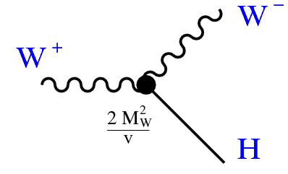
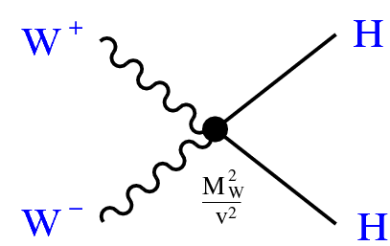
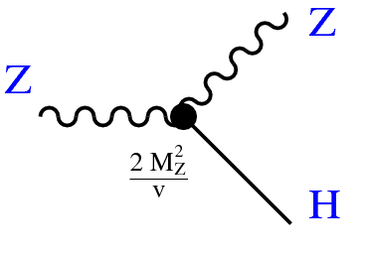
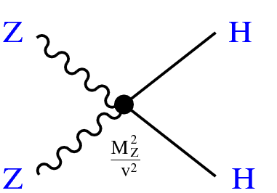
The Higgs sector of EW standard model
$$\frac{1}{8}\left(\begin{matrix}W_{3μ} & B_{μ}\end{matrix}\right)\left(\begin{matrix}g^{2} & −gg^{′} \\ −gg^{′} & g^{′2}\end{matrix}\right)\left(\begin{matrix}W_{3}^{μ} \\ B_{}^{μ}\end{matrix}\right)=\frac{1}{8}\left(\begin{matrix}Z_{μ} & A_{μ}\end{matrix}\right)\left(\begin{matrix}\cos{θ} & −\sin{θ} \\ \sin{θ} & \cos{θ}\end{matrix}\right)\left(\begin{matrix}g^{2} & −gg^{′} \\ −gg^{′} & g^{′2}\end{matrix}\right)\left(\begin{matrix}\cos{θ} & −\sin{θ} \\ \sin{θ} & \cos{θ}\end{matrix}\right)\left(\begin{matrix}Z^{μ} \\ A^{μ}\end{matrix}\right)$$
$=\frac{1}{8}\left(\begin{matrix}Z_{μ} & A_{μ}\end{matrix}\right)\left(\begin{matrix}{\left(g\cos{θ}{+}g^{′}\sin{θ}\right)}^{2} & \left(g\cos{θ}{+}g^{′}\sin{θ}\right)\left(g\sin{θ}{−}g^{′}\cos{θ}\right) \\ \left(g\cos{θ}{+}g^{′}\sin{θ}\right)\left(g\sin{θ}{−}g^{′}\cos{θ}\right) & {\left(g\sin{θ}{−}g^{′}\cos{θ}\right)}^{2}\end{matrix}\right)\left(\begin{matrix}Z^{μ} \\ A^{μ}\end{matrix}\right)$
Mass matrix of gauge boson is diagonalized: $g\sin{θ}{−}g^{′}\cos{θ}=0⇒\tan{θ}=\frac{g^{′}}{g}$
$$\frac{1}{8}\left(\begin{matrix}W_{3μ} & B_{μ}\end{matrix}\right)\left(\begin{matrix}g^{2} & −gg^{′} \\ −gg^{′} & g^{′2}\end{matrix}\right)\left(\begin{matrix}W_{3}^{μ} \\ B_{}^{μ}\end{matrix}\right)=\frac{1}{8}\left(\begin{matrix}Z_{μ} & A_{μ}\end{matrix}\right)\left(\begin{matrix}{\left(g\cos{θ}{+}g^{′}\sin{θ}\right)}^{2} & 0 \\ 0 & 0\end{matrix}\right)\left(\begin{matrix}Z^{μ} \\ A^{μ}\end{matrix}\right)$$
$$L_{\left(Higgs\right)}=\frac{1}{2}∂_{μ}η∂^{μ}η−\frac{1}{2}\left(2λv^{2}\right)η^{2}−λνη^{3}−\frac{λ}{4}η^{4}+\frac{g^{2}v^{2}}{4}W_{μ}^{†}W^{μ}+\frac{g^{2}v^{2}}{8\cos^{2}θ}Z_{μ}Z^{μ}$$
$$+\frac{g^{2}}{4}\left(2vη+η^{2}\right)W_{μ}^{†}W^{μ}+\frac{g^{2}}{8\cos^{2}θ}\left(2vη+η^{2}\right)Z_{μ}Z^{μ}$$
$M_{W}^{2}=\frac{g^{2}v^{2}}{4}$, $M_{Z}^{2}=\frac{g^{2}v^{2}}{4\cos^{2}θ}$ ; $m_{H}^{2}=2λv^{2}$

Slide 40
Interaction of leptons and quarks with gauge fields
$$D_{μ}^{\left(ℓ_{L}\right)}=∂_{μ}−igW_{aμ}T_{a}−i\frac{g^{′}}{2}Y_{ℓ_{Lα}}B_{μ}$$
$$D_{μ}^{\left(q_{L}\right)}=∂_{μ}−igW_{aμ}T_{a}−i\frac{g^{′}}{2}Y_{q_{Lα}}B_{μ}$$
$$D_{μ}^{\left(q_{R}\right)}=∂_{μ}−i\frac{g^{′}}{2}Y_{ℓ_{Rβ}}B_{μ}$$
$$D_{μ}^{\left(ℓ_{R}\right)}=∂_{μ}−i\frac{g^{′}}{2}Y_{ℓ_{Rβ}}B_{μ}$$
Using, $\left(\begin{matrix}W_{3}^{μ} \\ B^{μ}\end{matrix}\right)=\left(\begin{matrix}\cos{θ} & −\sin{θ} \\ \sin{θ} & \cos{θ}\end{matrix}\right)\left(\begin{matrix}Z^{μ} \\ A^{μ}\end{matrix}\right)$, $W_{μ}=\frac{1}{\sqrt{2}}\left(W_{1μ}+iW_{2μ}\right)$
$$g^{′}=g\tan{θ}$$
$$L_{lepton}=L_{0}+\frac{g}{2\sqrt{2}}{\overline{v}}_{α}γ^{μ}(1−γ^{5})e_{α}W_{μ}^{†}+\frac{g}{2\sqrt{2}}{\overline{e}}_{α}γ^{μ}(1−γ^{5})v_{α}W_{μ}$$
$+\frac{g}{4cosθ}{\overline{v}}_{α}γ^{μ}\left(1−γ^{5}\right)v_{α}Z_{μ}−\frac{g}{4cosθ}{\overline{e}}_{α}γ^{μ}\left(x_{0}−γ^{5}\right)e_{α}Z_{μ}−e{\overline{e}}_{α}γ^{μ}e_{α}A_{μ}$
Where, $e=g\sin{θ}$, $x_{0}=1−4 \sin^{2}θ$
$$\begin{matrix}L_{quark}=L_{0}+\frac{g}{2\sqrt{2}}{\overline{u}}_{α}γ^{μ}(1−γ^{5})d_{α}W_{μ}^{†}+\frac{g}{2\sqrt{2}}{\overline{d}}_{α}γ^{μ}(1−γ^{5})u_{α}W_{μ} \\ +\frac{g}{4cosθ}{\overline{u}}_{α}γ^{μ}(a−bγ^{5})u_{α}Z_{μ}−\frac{g}{4cosθ}{\overline{d}}_{α}γ^{μ}(c−dγ^{5})d_{α}Z_{μ} \\ +\frac{2}{3}e{\overline{u}}_{α}γ^{μ}u_{α}A_{μ}−\frac{1}{3}e{\overline{d}}_{α}γ^{μ}d_{α}A_{μ}\end{matrix}$$
Where, $a=1−\frac{8}{3}\sin^{2}θ, b=1; c=1−\frac{4}{3}\sin^{2}θ, d=1$

Slide 41
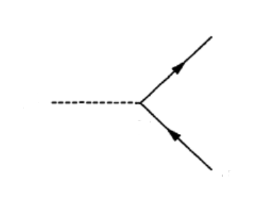
Yukawa couplings and CKM matrix
I$n unitary guage φ\left(x\right)=\frac{1}{\sqrt{2}}\left(\begin{matrix}0 \\ v+η(x)\end{matrix}\right)$, $\tilde{φ}=−i\left(τ_{2}^{T}φ^{∗}\right)=\frac{1}{\sqrt{2}}\left(\begin{matrix}v+η(x) \\ 0\end{matrix}\right)$
$$q_{Lα}=\left(\begin{matrix}u_{Lα} \\ d_{Lα}\end{matrix}\right), q_{\left.R(β+3\right)}=d_{Rβ},q_{Rβ}=u_{Rβ}$$
$$L_{\text{(}\text{Yuk}\text{)}}=−\frac{1}{\sqrt{2}}\left(\begin{matrix}{\overline{u}}_{Lα} & {\overline{d}}_{Lα}\end{matrix}\right)\left(\begin{matrix}0 \\ v+η\end{matrix}\right)M_{αβ}d_{Rβ}\text{+ }\text{h}\text{.}\text{c}−\frac{1}{\sqrt{2}}\left(\begin{matrix}{\overline{u}}_{Lα} & d_{Lα}\end{matrix}\right)\left(\begin{matrix}v+η \\ 0\end{matrix}\right){\tilde{M}}_{αβ}u_{Rβ}\text{+ }\text{h}\text{.}\text{c}\text{.}$$
$$L_{\text{(}\text{Yuk}\text{)}}=−\frac{1}{\sqrt{2}}(v+η){\overline{d}}_{Lα}M_{αβ}d_{Rβ}\text{+ }\text{h}\text{.}\text{c}−\frac{1}{\sqrt{2}}(v+η){\overline{u}}_{Lα}{\tilde{M}}_{αβ}u_{Rβ}\text{+ }\text{h}\text{.}\text{c}\text{.}$$
$=−\frac{1}{\sqrt{2}}(v+η){\overline{d}}_{L}Md_{R}\text{+ }\text{h}\text{.}\text{c}−\frac{1}{\sqrt{2}}(v+η){\overline{u}}_{L}\tilde{M}u_{R}\text{+ }\text{h}\text{.}\text{c}\text{.}$
$$ℓ$$
Let, $A_{d}MB_{d}^{−1}=D_{d},$ $A_{u}MB_{u}^{−1}=D_{u}$
H
$$L_{\text{(}\text{Yuk}\text{)}}=−\frac{1}{\sqrt{2}}(v+η){\overline{d}}_{L}A_{d}^{−1}D_{d}B_{d}d_{R}\text{+ }\text{h}\text{.}\text{c}−\frac{1}{\sqrt{2}}(v+η){\overline{u}}_{L}A_{u}^{−1}D_{u}B_{u}u_{R}\text{+ }\text{h}\text{.}\text{c}\text{.}$$
$$\frac{m_{ℓ}}{\sqrt{2}v}$$
$$ℓ$$
Let, $d_{R}^{′}=B_{d}d_{R},$ $d_{L}^{′}=A_{d}d_{L}$, $u_{R}^{′}=B_{u}u_{R}$, $u_{L}^{′}=A_{u}u_{L}$
$$q$$
$$L_{\text{(}\text{Yuk}\text{)}}=−\frac{1}{\sqrt{2}}(v+η){\overline{d}}_{L}^{′}D_{d}d_{R}^{′}\text{+ }\text{h}\text{.}\text{c}−\frac{1}{\sqrt{2}}(v+η){\overline{u}}_{L}^{′}D_{d}u_{R}^{′}\text{+ }\text{h}\text{.}\text{c}\text{.}$$
H
$$\frac{m_{q}}{\sqrt{2}v}$$
$$q$$

Slide 42
Yukawa couplings and CKM matrix
$$\begin{matrix}L_{quark}=L_{0}+\frac{g}{2\sqrt{2}}\overline{u}γ^{μ}\left(1−γ^{5}\right)dW_{μ}^{†}+\frac{g}{2\sqrt{2}}\overline{d}γ^{μ}\left(1−γ^{5}\right)uW_{μ} \\ +\frac{g}{4cosθ}\overline{u}γ^{μ}\left(a−bγ^{5}\right)uZ_{μ}−\frac{g}{4cosθ}\overline{d}γ^{μ}\left(c−dγ^{5}\right)dZ_{μ} \\ +\frac{2}{3}e\overline{u}γ^{μ}uA_{μ}−\frac{1}{3}e\overline{d}γ^{μ}dA_{μ}\end{matrix}$$
$d_{R}^{′}=B_{d}d_{R},$ $d_{L}^{′}=A_{d}d_{L}$, $u_{R}^{′}=B_{u}u_{R}$, $u_{L}^{′}=A_{u}u_{L}$
$$\overline{u}γ^{μ}\left(a−bγ^{5}\right)u=a_{R}{\overline{u}}_{R}γ^{μ}u_{R}+a_{L}{\overline{u}}_{L}γ^{μ}u_{L}$$
$=a_{R}{\overline{u}}_{R}^{′}γ^{μ}u_{R}^{′}+a_{L}{\overline{u}}_{L}^{′}γ^{μ}u_{L}^{′}={\overline{u}}^{′}γ^{μ}\left(a−bγ^{5}\right)u^{′}$
$$\overline{u}γ^{μ}\left(1−γ^{5}\right)d={\overline{u}}_{L}γ^{μ}d_{L}={\overline{u}}_{L}^{′}A_{u}γ^{μ}A_{d}^{−1}d_{L}^{′}={\overline{u}}_{L}^{′}γ^{μ}Vd_{L}^{′}$$
$$\overline{d}γ^{μ}\left(1−γ^{5}\right)u={\overline{u}}_{L}^{′}γ^{μ}V^{†}d_{L}^{′}$$

Slide 43
Yukawa couplings and CKM matrix
$$\begin{matrix}L_{quark}=L_{0}+\frac{g}{2\sqrt{2}}\overline{u}γ^{μ}\left(1−γ^{5}\right)VdW_{μ}^{†}+\frac{g}{2\sqrt{2}}\overline{d}γ^{μ}\left(1−γ^{5}\right)V^{†}uW_{μ} \\ +\frac{g}{4cosθ}\overline{u}γ^{μ}\left(a−bγ^{5}\right)uZ_{μ}−\frac{g}{4cosθ}\overline{d}γ^{μ}\left(c−dγ^{5}\right)dZ_{μ} \\ +\frac{2}{3}e\overline{u}γ^{μ}uA_{μ}−\frac{1}{3}e\overline{d}γ^{μ}dA_{μ}\end{matrix}$$
$$\begin{matrix}L_{quark}=L_{0}+\frac{gV_{αα′}}{2\sqrt{2}}{\overline{u}}_{α}γ^{μ}(1−γ^{5})d_{α′}W_{μ}^{†}+\frac{gV_{α′α}^{∗}}{2\sqrt{2}}{\overline{d}}_{α}γ^{μ}(1−γ^{5})u_{α′}W_{μ} \\ +\frac{g}{4cosθ}{\overline{u}}_{α}γ^{μ}(a−bγ^{5})u_{α}Z_{μ}−\frac{g}{4cosθ}{\overline{d}}_{α}γ^{μ}(c−dγ^{5})d_{α}Z_{μ} \\ +\frac{2}{3}e{\overline{u}}_{α}γ^{μ}u_{α}A_{μ}−\frac{1}{3}e{\overline{u}}_{α}γ^{μ}u_{α}A_{μ}\end{matrix}$$
Appearance of CKM matrix in CC current interactions implies that any down type quark can go
into any up type quark through CC interaction vertex.
$$d_{α′}$$
$$u_{α′}$$
$$q_{α}$$
$$q_{α}$$
$$W^{+}$$
$$W^{+}$$
$$Z^{0}$$
$$γ$$
$$\frac{gV_{αα′}}{2\sqrt{2}}$$
$$\frac{gV_{α′α}^{∗}}{2\sqrt{2}}$$
$$\frac{g}{4 cosθ}$$
$$eQ$$
$$u_{α}$$
$$d_{α}$$
$$q_{α}$$
$$q_{α}$$

Slide 44
The gauge sector of EW standard model
$$B_{μν}=∂_{μ}B_{ν}−∂_{ν}B_{μ}$$
$$\begin{matrix} \\ W_{aμν}=∂_{μ}W_{aν}−∂_{ν}W_{aμ}+gε_{abc}W_{bμ}W_{cν}\end{matrix}$$
$$−\frac{1}{4}B_{μν}B^{μν}=−\frac{1}{4}\left(∂_{μ}B_{ν}−∂_{ν}B_{μ}\right)\left(∂^{μ}B^{ν}−∂^{v}B^{μ}\right)\begin{matrix} \\ \\ \end{matrix}$$
$$−\frac{1}{4}W_{aμν}W_{a}^{μν}=−\frac{1}{4}\left(∂_{μ}W_{aν}−∂_{ν}W_{aμ}\right)\left(∂^{μ}W_{a}^{v}−∂^{ν}W_{a}^{μ}\right)−\frac{g}{2}ε_{abc}\left(∂_{μ}W_{aν}−∂_{ν}W_{aμ}\right)W_{b}^{μ}W_{c}^{ν}−\frac{g^{2}}{4}ε_{abc}ε_{amn}W_{bμ}W_{cν}W_{m}^{μ}W_{n}^{ν}$$
Using, $\left(\begin{matrix}W_{3μ} \\ B_{μ}\end{matrix}\right)=\left(\begin{matrix}\cos{θ} & −\sin{θ} \\ \sin{θ} & \cos{θ}\end{matrix}\right)\left(\begin{matrix}Z_{μ} \\ A_{μ}\end{matrix}\right)$, $W_{μ}=\frac{1}{\sqrt{2}}\left(W_{1μ}+iW_{2μ}\right)$

Slide 45
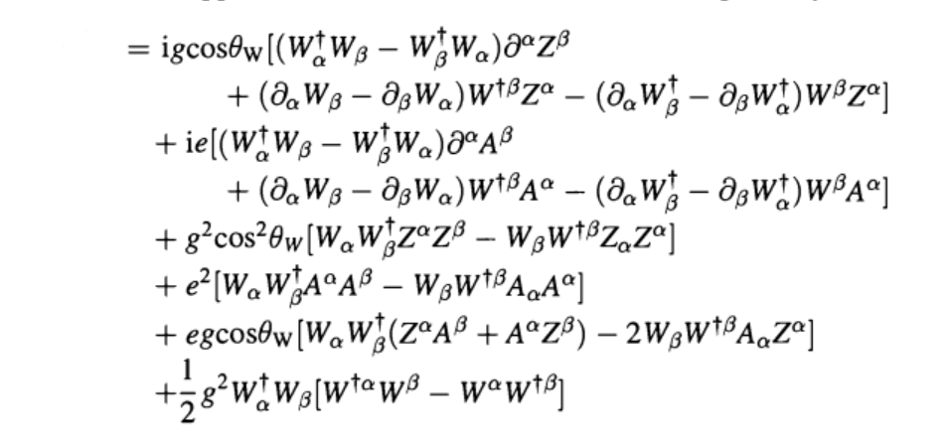
The gauge sector of EW standard model
$$𝓛_{(gauge)}$$
$$γ$$
$$e$$
$$g^{2}/2$$
$$e^{2}$$
$$Z$$
$$gcos θ$$
$$g^{2}\cos^{2}θ$$
$$Z$$

