Slide 1
Electron-Electron Interaction Driven Exotic SCs on Quasicrystals
Fan Yang (杨帆)
Beijing Institute of Technology
（北京理工大学）
2023-6-30 West Lake University, Hangzhou

Slide 2
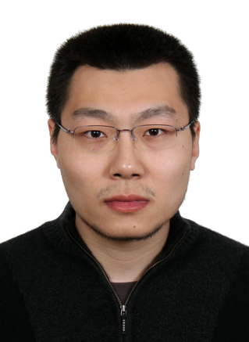
Collaborators
Ye Cao (BIT)
Yu-Bo Liu (BIT)
Yong-You Zhang (BIT)
Wei-Qiang Chen (SUST)
Jing Zhou(CUPT）
Congjun Wu (WLU)

Slide 3
Outline
Introduction
Exotic SC states driven by e-e interaction on intrinsic QCs
Exotic SC states driven by e-e interaction on extrinsic QCs
Discussions & Conclusion
Y. Cao, et al, Phys. Rev. Lett. 125, 017002(2020); Y.-B. Liu, et al, Phys. Rev. B 107, 014501 (2023).
Y. Zhang, et al, SCPMA 65, 287411 (2022); Y.-B. Liu, et al, arXiv: 2301.07553 ; arXiv: 2301.06357.

Slide 4
Outline
Introduction
Exotic SC states driven by e-e interaction on intrinsic QCs
Exotic SC states driven by e-e interaction on extrinsic QCs
Discussions & Conclusion
Y. Cao, et al, Phys. Rev. Lett. 125, 017002(2020); Y.-B. Liu, et al, Phys. Rev. B 107, 014501 (2023).
Y. Zhang, et al, SCPMA 65, 287411 (2022); Y.-B. Liu, et al, arXiv: 2301.07553 ; arXiv: 2301.06357.

Slide 5
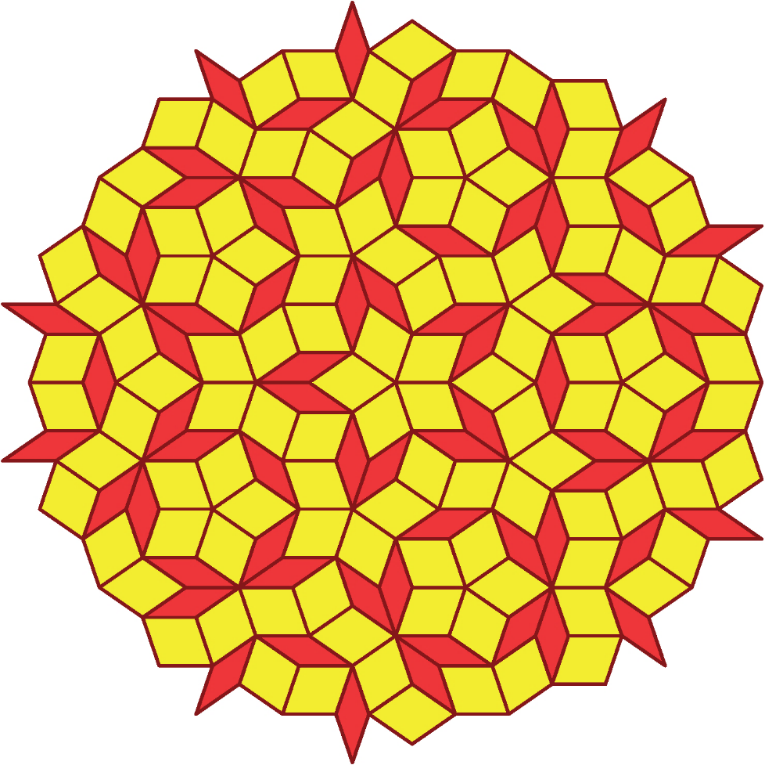
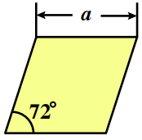
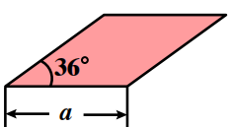
The QC Structure
The Penrose tiling
5D cubic to 2D
Long-range ordered structure
A. Rotation symmetry
B. No translation symmetry
C. Projection of high-D
crystal lattice to low-D
D. Any finite-size section
repeats infinite times

Slide 6
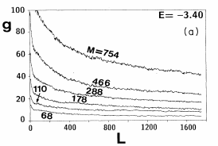
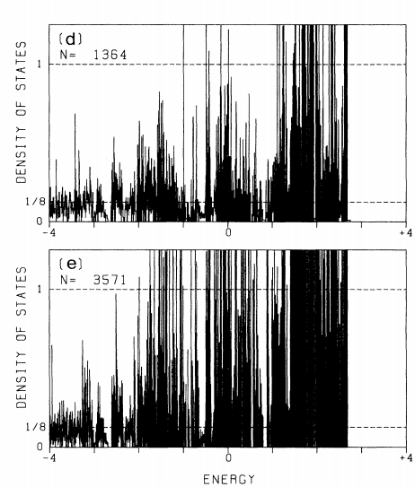
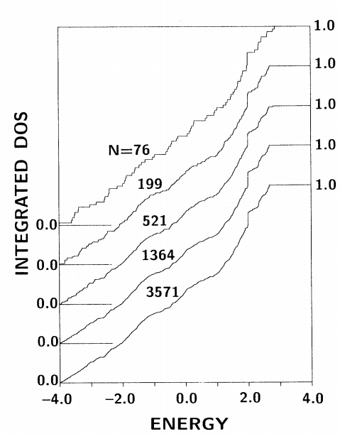
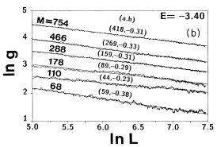
Electron Structure of QC
Electronic state: M-I-T critical point
A. No translation symmetry: no
B. Singular smooth DOS (pseudogap, fractal)
C. Critical wave function

Slide 7
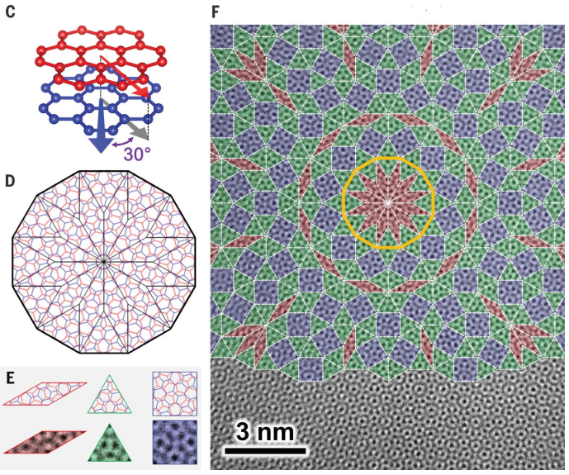
Intrinsic QC & Extrinsic QC
Intrinsic QC: e.g. Penrose
Extrinsic QC: twisted multilayers of crystals
Examples of Ext QCs: 30º-TBG; 45º-TB cuprates
The synthesized 30º-TBG
side view
No translational period
Point group: D_{6d}~D₁₂
Projection of 4D crystal into 2D
Belong to extrinsic QC
top view
minimum
unit
Ahn, et al., Science 361, 782–786 (2018)
W. Yao, et al, PNAS 115, 6928 (2018).

Slide 8
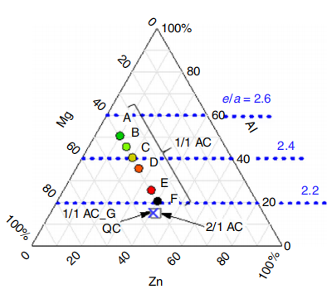
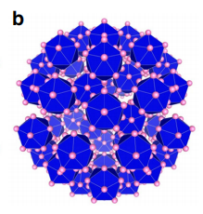
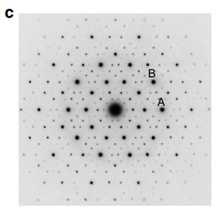
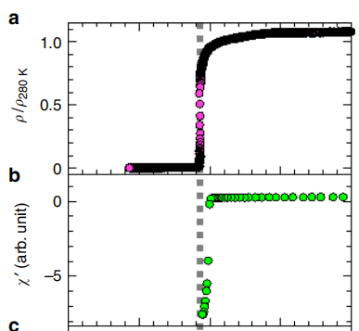
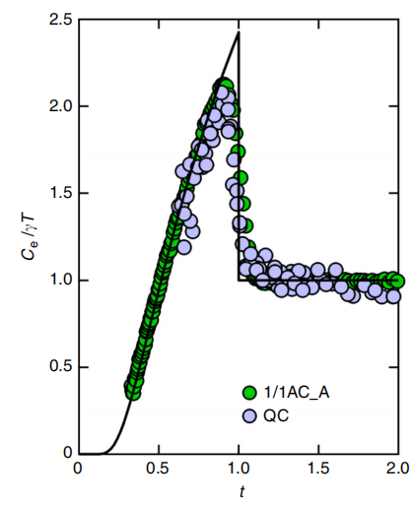
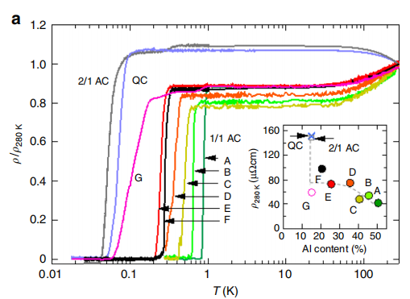
Superconductivity (SC) on QC
Superconducting Al–Zn–Mg QC
K. Kamiya, et al, Nat Commun 9:154 (2018)

Slide 9
Fundmental Issues For SCs on QCs
What’s the pairing mechanism for SC on QC ?
How to classify pairing symmetries on QCs ?
What’s the universal properties of SCs on QCs ?
Can QCs generate novel SCs absent on crystals ?

Slide 10
Outline
Introduction
Exotic SC states driven by e-e interaction on intrinsic QCs
Exotic SC states driven by e-e interaction on extrinsic QCs
Discussions & Conclusion
Y. Cao, et al, Phys. Rev. Lett. 125, 017002(2020); Y.-B. Liu, et al, Phys. Rev. B 107, 014501 (2023).
Y. Zhang, et al, SCPMA 65, 287411 (2022); Y.-B. Liu, et al, arXiv: 2301.07553 ; arXiv: 2301.06357.

Slide 11
Background & Questions
Unconventional SCs driven by repulsive interactions
The Kohn-Luttinger mechanism on crystals
A. The e-e interaction can be renormalized
B. The renormalized e-e interaction is anisotropic on the FS
C. Can be decomposed into various eigen channels
D. The most-negative-eigenvalue channel is realized to cause SC
E. Technically represented by RPA, FLEX, FRG......
Can the K-L mechanism be generalized to QC?
Properties of unconventional SCs on QC?
Y. Cao, et al, Phys. Rev. Lett. 125, 017002(2020)

Slide 12
The BCS theory for SC
The Cooper instability and BCS theory
The mean-field theory
How about direct repulsive e-e interaction?
e
attraction
BEC
e
e
superconductivity
e
cooper pair
The effective attraction is mediated by electron-phonon coupling

Slide 13
The Kohn-Luttinger Mechanism
No Mean-field SC for the +U Hubbard model
The second-order perturbative effective H
find , so that
各取一个particle-hole形的激发，Wick收缩

Slide 14
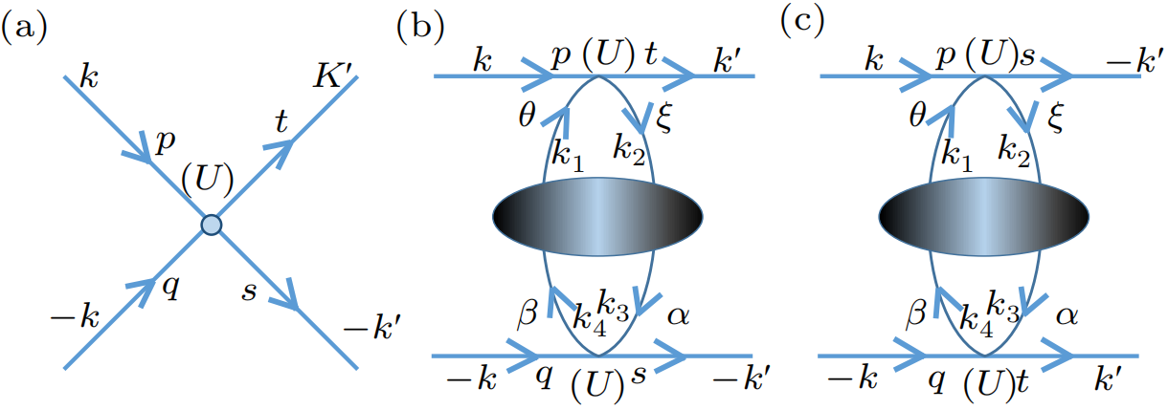
The Kohn-Luttinger Mechanism
The Feyman’s diagram
The effective interaction

Slide 15
The Kohn-Luttinger Mechanism
MF treatment of the effective H
The pairing symmetry: determined by
The Tc : determined by the largest
Usually lead to unconventional SC (non s-wave)

Slide 16
The Kohn-Luttinger instability on QCs
The Hubbard model on the QC
The second-order perturbative effective H
find , so that
各取一个particle-hole形的激发，Wick收缩

Slide 17
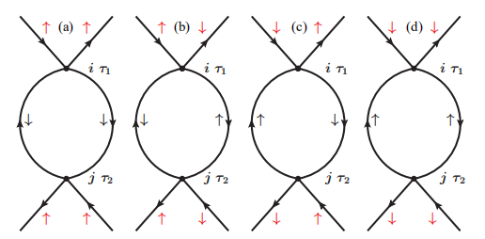
The Kohn-Luttinger instability on QCs
The real-space perturbative approach
取零频

Slide 18
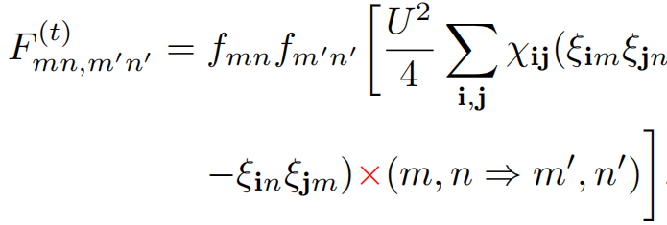
The Kohn-Luttinger instability on QCs
Mean-field treatment of
Linearized gap equation near T_{c}
function of T

Slide 19
Classification of pairing symmetries
The gap function always has two-variables
The classification is slightly different from crystals
Gap functions with the same Tc form an IRRP of D₅
: real space
or
: eigen space
Four pairing symmetries of the Penrose tiling based on IRRPs of D₅

Slide 20
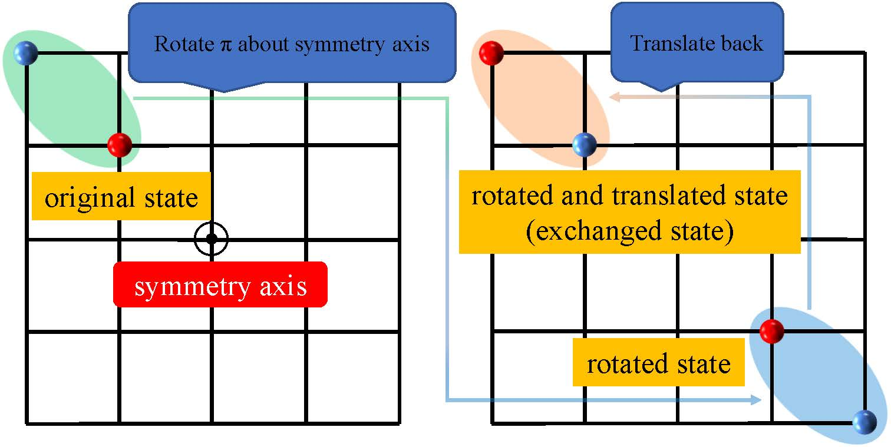
Classification of pairing symmetry
Relation between pairing angular momentum and spin statistics
平移不变系统：交换两个粒子位置等价于旋转180°+平移
单态：空间角动量是偶数
三重态：空间角动量是奇数
Pauli’s exclusion principle:

Slide 21
Classification of pairing symmetry
Lack of translation symmetry on the QC
s -wave: singlet or triplet
p-wave: singlet or triplet
d-wave: singlet or triplet
h-wave: singlet or triplet
angular momentum around the lattice center
spin statistics
unrelated

Slide 22
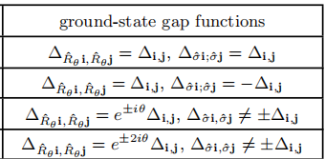
Topological SCs on QC
Two 2D IRRPs of D₅ - : (p_{x},p_{y}), (d_{x2-y2},d_{2xy})
Possible G-L free-energy minimum: p+ip and d+id, singlet or triplet TSC
With each rotation for i and j simultaneously,

Slide 23
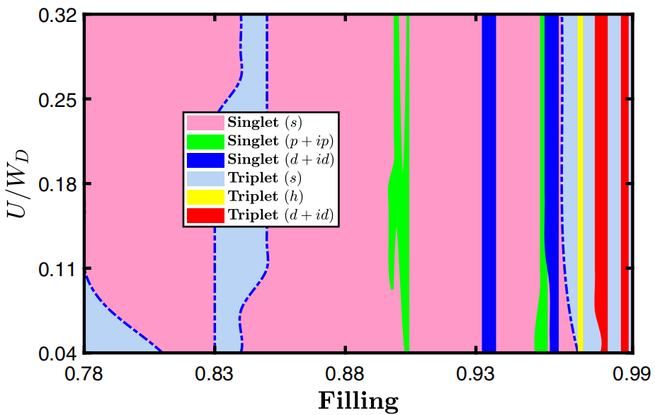
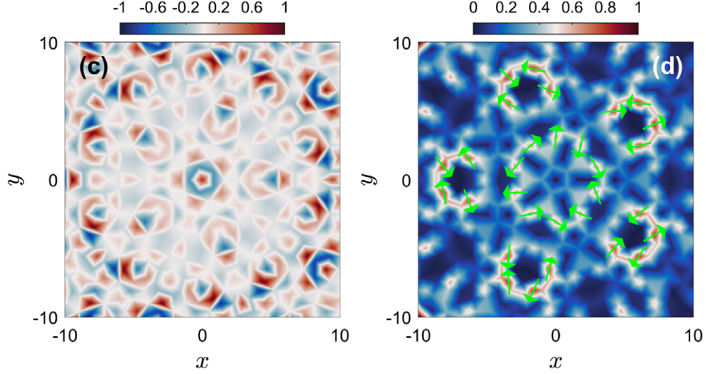
Pairing Phase diagram
Pairing phase diagram
Distinguished by phase-sensitve experiments
s-wave singlet
d+id-wave triplet
pairing phase diagram
contour plot of as function of i

Slide 24
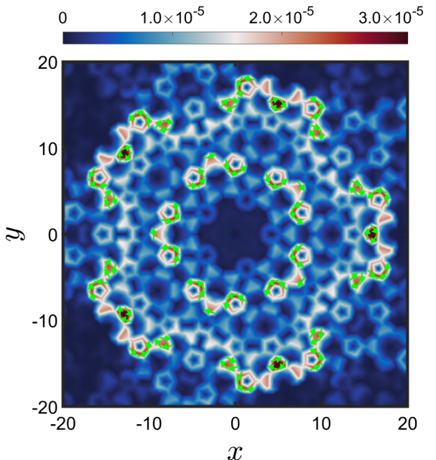
Spontaneous bulk current for chiral TSC
Chiral TSC on crystals: spontaneuos edge current
Chiral TSC on QCs: spontaneuos bulk current
Set A=0, spontaneous super current
crystal: current appear where the translation symmetry breaks, edge
QC: current appear everywhere as the translation symmetry breaks in the bluk!

Slide 25
Brief Summary for Topic I
The K-L pairing mechanism generized to QC
Pairing symmetries classified by IRRPs of D₅
Universal spontaneous bulk current for chiral TSC
(Rare on periodic lattices)
Y. Cao, et al, Phys. Rev. Lett. 125, 017002(2020)

Slide 26
Outline
Introduction
Exotic SC states driven by e-e interaction on intrinsic QCs
Exotic SC states driven by e-e interaction on extrinsic QCs
Discussions & Conclusion
Y. Cao, et al, Phys. Rev. Lett. 125, 017002(2020); Y.-B. Liu, et al, Phys. Rev. B 107, 014501 (2023).
Y. Zhang, et al, SCPMA 65, 287411 (2022); Y.-B. Liu, et al, arXiv: 2301.07553 ; arXiv: 2301.06357.

Slide 27
Main points for Topic II
The extrinsic QC: periodic in each layer
Quasi-period : reflected in weak interlayer coupling
New SC mechanism for extrinsic QC:
Monolayer SC + interlayer Josephson coupling (IJC)
Such IJC can generate various exotic SCs
A. Make chiral TSC from non-TSC
B. Charge-4e SC emerges as vestigial phase
Y.-B. Liu, et al, Phys. Rev. B 107, 014501 (2023); arXiv: 2301.07553 ; arXiv: 2301.06357.

Slide 28
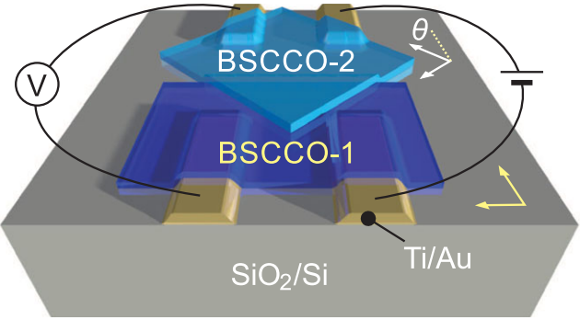
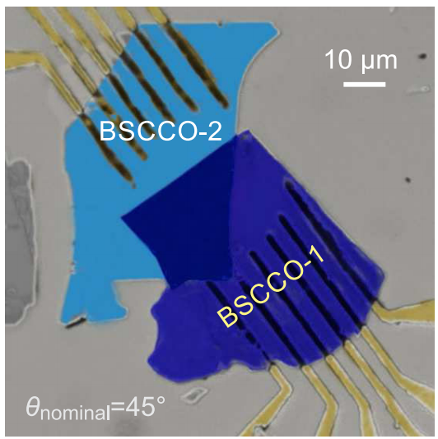
A Special Case:The 45º-TB Cuprates
Each D₄ -symmetric monolayer carries d-wave SC with pairing angular momentum (PAM) L=2
The 45º-TB : forms an extrinsic QC
The two ODPs can couple through IJC
The Ginzburg-Landau theory: d+id chiral TSC
Y. Zhu, et al,
PRX2021
O. Can, et al, Nat. Phys. 17, 519(2021)

Slide 29
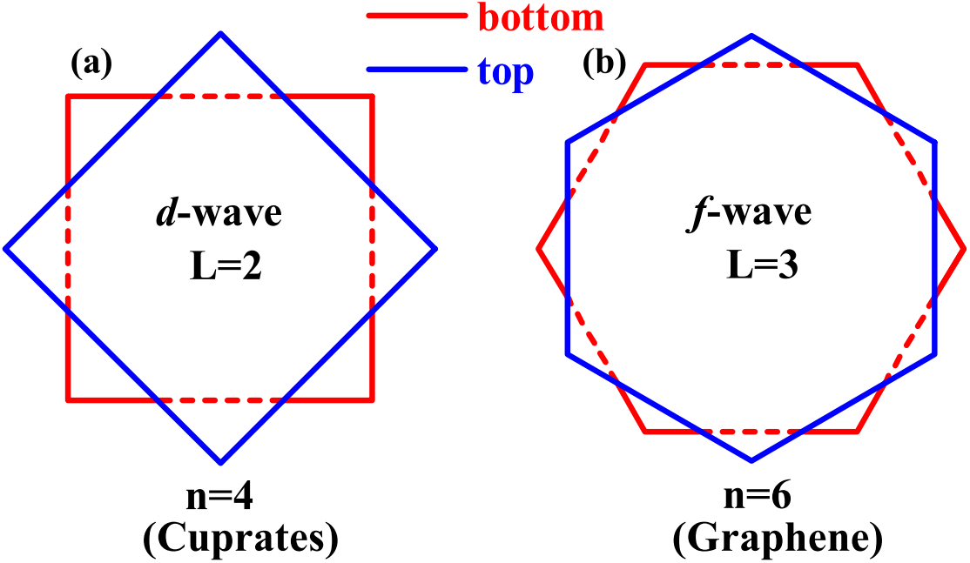
Our General Theory
Take a twist bilayer. Suppose each D_{n}-symmetric (n=4/6) crystalline monolayer carries non-TSC with PAM L=n/2
Maximumly twist: D_{nd} ~D_{2n} . Consequence of IJC?
Ground-state phase: chiral TSC (d+id (n=4) ; f+if (n=6) )
Vestigial phases: charge-4e SC & chiral metal
Based on G-L theory and combined RG/MC calculations.
Y.-B. Liu, et al, PRB 2023 ;
arXiv: 2301.07553;
arXiv: 2301.06357

Slide 30
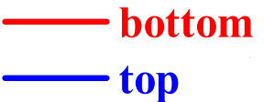
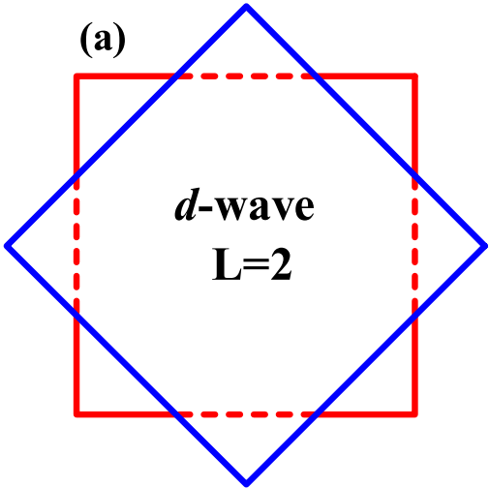
G-L Theory: Ground State
Pairing gap ; form factor ;amplitude
The fixed form factor for
The G-L free energy functional
,
+
+
-
-
-
-
+
+
Y.B.Liu, et al, arXiv: 2201.01656; ibid 2301.07553

Slide 31
G-L Theory: Ground State
The first-order IJC : satisfies U(1)- and TR
Invariance of under dictates
The second-order IJC:
Minimization of free energy:
+
+
-
-
-
-
+
+

chiral d+id/f+if TSC
determined by microscopic calc
nematic d/f SC

Slide 32
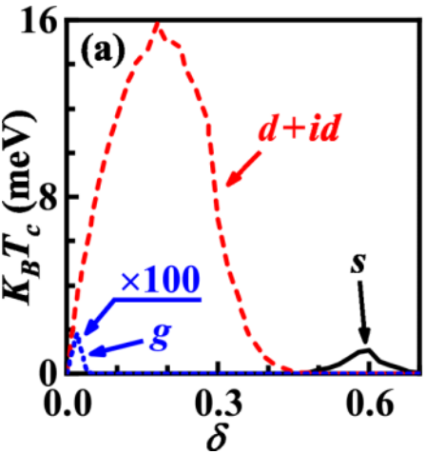
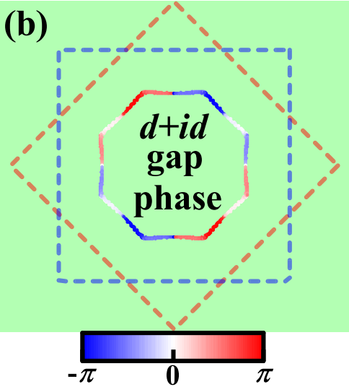
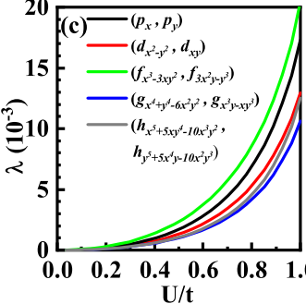
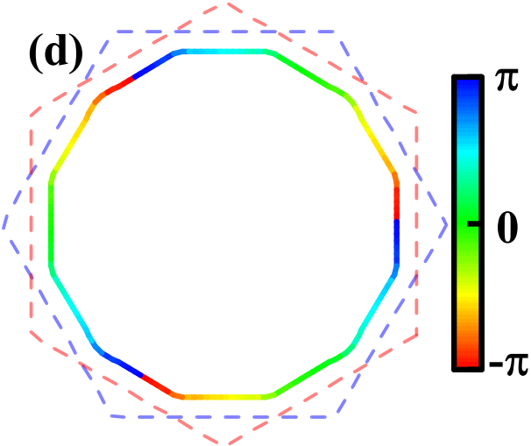
Two examples : 45º-TB cuprates; 30º-TBG
d+id TSC in 45º-TBC
n=4, L=n/2=2
Results of microscopic calculations based on perturbational-band theory
f+if TSC in 30º-TBG
n=6, L=n/2=3

Slide 33
The Charge-4e SC
Charge-4e SC: long-sought novel SC beyond BCS
Real SC: Zero resistivity and Meissner effect
Characterized by half flux quantization : hc/4e
Many properties unknown, e.g. gapped or not?
Lack of unambiguous material realization
BEC
e
e
superconductivity with
fractionalized flux
e
e
4e -- bound state

Slide 34
Charge-4e SC in TB-QCs
Inspired by the great idea of Prof. Congjun Wu
M. Zeng, L.-H. Hu, H.-Y. Hu, Y.-Z. You, and C. Wu, arXiv: 2102.06158
Pairing-phase fluctuations in a bilayer system
Low-energy effective Hamitonian of TB-QCs
Get the phase diagram by combined RG & MC
Physical quantities and correlations by MC
Total phase locked; relative phase fluctuate: charge-4e SC
Relative phase locked; total phase fluctuate: chiral metal

Slide 35
Low-Energy Effective Model
Fix , set : spatial fluctuation
Focus on the phase fluctuation
The total- and relative- phase fields
Low-energy effective Hamiltonian
( )
,

Slide 36
Low-Energy Effective Model
Symmetry operation under
Invariance of Hamiltonian H under requires
The resultant classical Hamiltonian
, : stiffness parameters
Y.B.Liu, et al, arXiv: 2301.06357

Slide 37
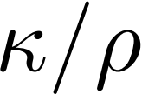
Low-Energy Effective Model
Three types of vortices
Various phases and phase diagram
When T 0, all vortex--anti-vortex pairs chiral TSC
When T , determined by T and
,
integer vortex
half-half vortex
,
vortices first unilateral proliferate: charge-4e SC
vortices first unilateral proliferate: chiral metal
half - half vortices first proliferate: normal metal

Slide 38
The RG Study
The action at temperature T
Map to the Sine-Gordan model
M. Zeng, et al, arXiv: 2102.06158
,
: dual vortex fields
,
,
: fugacities of three vortex fields

Slide 39
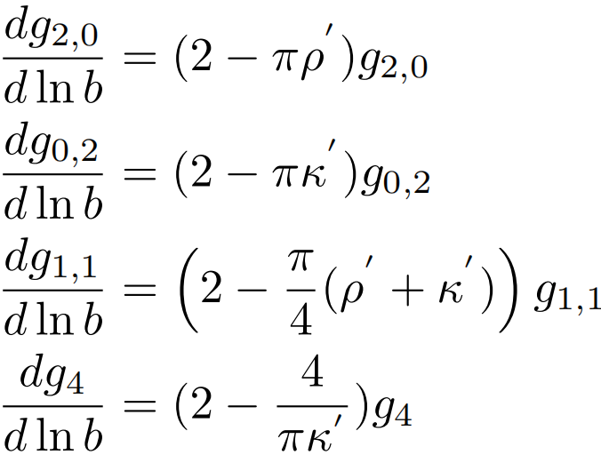
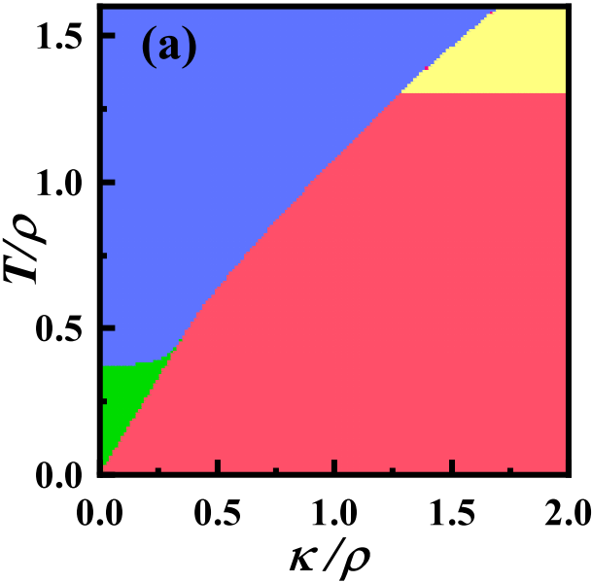
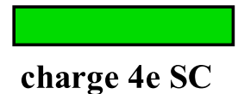
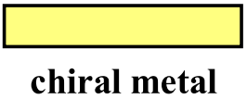
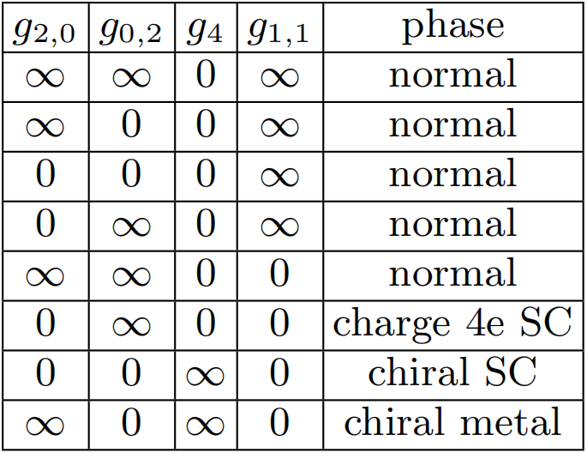
One-Loop RG Phase Diagram
Y.B.Liu, et al, arXiv: 2301.06357

Slide 40
The Monte-Carlo Study
Calculate physical quantities by Monte-Carlo
Superfluid density: , the Ising ODP:
Susceptibility , correlation function
, : the insert flux; : the free energy
M. Zeng, et al, arXiv: 2102.06158

Slide 41
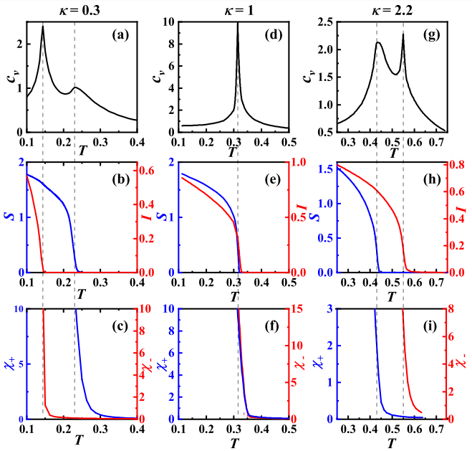
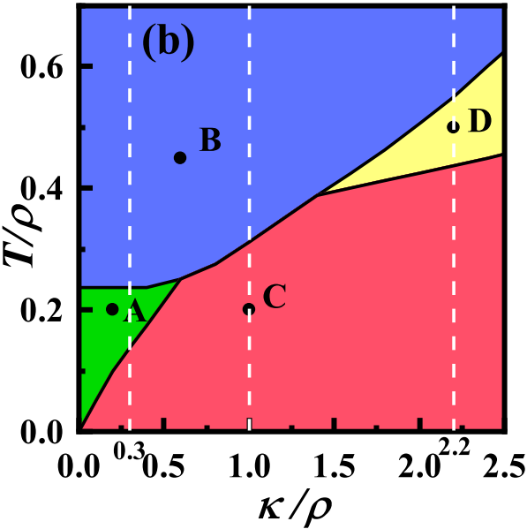
The Monte-Carlo Results
Y.B.Liu, et al, arXiv: 2301.06357
MC phase diagram
T dependences of quantities

Slide 42
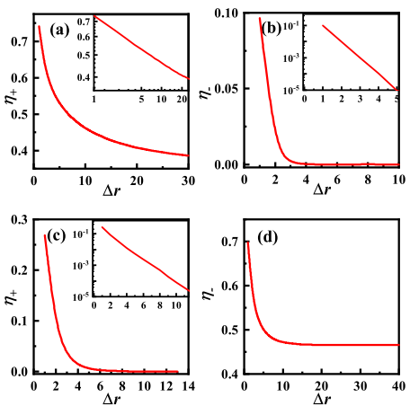
The Monte-Carlo Results
Y.B.Liu, et al, arXiv: 2301.06357
point A
point
D
MC phase diagram
Correlation functions for A and D

Slide 43
Conclusion
SCs driven by e-e interaction on QCs investigated
For intrinsic QCs:
A. The K-L pairing mechanism applies
B. Pairing symmetries classified
C. Universal spontaneous bulk current in chiral TSCs
The extrinsic QCs:
A. Make chiral TSCs from non-TSCs
B. Realize the long-sought charge-4e SC
More exotic electron instabilities on QCs.
SDW, CDW, Spin Liquid, ......
Thanks!

Slide 44
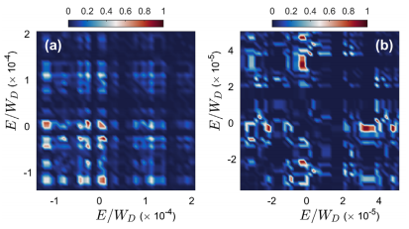
Classification of pairing symmetry
Breaking of Anderson's theorem
s-wave singlet
d+id-wave triplet
m and n dependence of : each m state will pair with all n

Slide 45
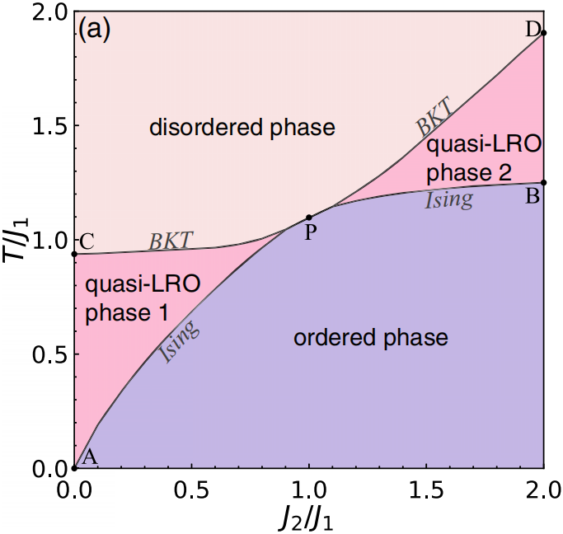
Charge-4e SC in Hetostructure Bilayer
Charge-4e SC in hetostructure bilayer by IJC.
J_{1/2} : phase stiffness in layer 1/2
K: second-order IJC
When T 0, both layers host SC
When T , SC2 is first killed, (for J₂<J₁)
-- unilateral quasi-ordering: SC1
-- Z₂ fluctuation under the IJC: kill SC2
*2
-- quasi-ordering: charge-4e SC in layer2
F. F. Song, et al, PRL2022
Charge-4e SC in layer 2 induced by charge-2e SC in layer 1 through IJC
Difficult in experiment detection: The half flux quantization invisible

