Slide 1




Unconventional magnetism and spontaneous
spin-orbit ordering
Congjun Wu (Westlake University)
$$\vec{s}$$
$$\vec{s}$$
$$k_{f2}$$
$$k_{f1}$$
Ref. 1) C. Wu and S. C. Zhang, PRL 93, 36403 (2004);
2) C. Wu, K. Sun, E. Fradkin, and S. C. Zhang, PRB 75, 115103 (2007).
3) C. L. Song, et al, Science 332, 1410 (2011).
4) Y. Li, C. Wu, PRB 85, 205126 (2012).
5) Z. Pan, C.Wu, in preparation.
04/10/2024, Westlake Univ.
Notes:
The motivation is as follows: Spin-orbit coupling plays an important role in solid state physics, in particular, in the recent focus of topological states of matter. Conventionally spin-orbit coupling is viewed as a single-particle property inherited from relativistic Dirac equation, not directly related to many-body interactions. In this talk, I will explore another possibility – spontaneously generate spin-orbit coupling through many-body interactions through an unconventional generalization of magnetic phase transitions. This figure shows the Fermi surface structure of an isotropic unconventional magnetic state. We also extended the interacting Fermi-liquid theory to systems with spin-orbit coupling. Here are related references.

Slide 2
Collaborators
S. C. Zhang, Stanford.
E. Fradkin, UIUC.
D. Arovas, UCSD
K. Sun, UIUC (now at U. Michigan)
W. C. Lee, UCSD (now at Binghamton, SUNY)
Y. Li, UCSD (now at Johns Hopkins)
Z. M. Pan, Westlake
Thanks to J. Hirsch, M. Beasley, A. L. Fetter, S. Kivelson, J. Zaanen, S. Das Sarma,, A. J. Leggett, L. Balents for stimulating discussions.
Notes:
Let me thank my collaborators.

Slide 3
Introduction
unconventional superconductivity
unconventional symmetries
unconventional magnetism
nematic electron liquid with spin
spin-orbit coupling
Notes:
This is the introduction of the talk. I will explain what is unconventional magnetism and show it has close connections to three important research directions of modern condensed matter physics, including unconventional superconductivity, anisotropic electron liquid state, and spin-orbit coupling. First, let me make a comparison between unconventional superconductivity and unconventional magnetism from the perspective of symmetry properties --they share the same unconventional symmetry structures.

Slide 4
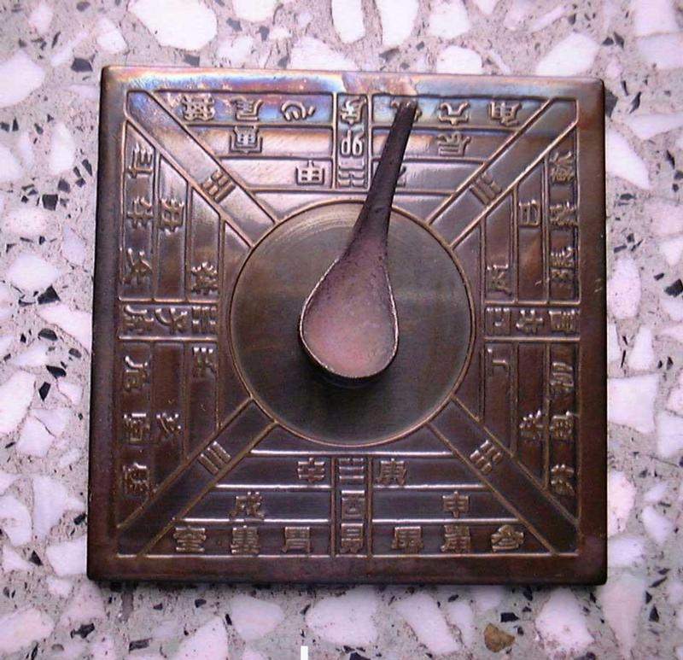
The early age of ferromagnetism
慈 (ci) 石(shi) 召(zhao) 铁(tie)
The magnetic stone attracts iron.
---- Guiguzi (鬼谷子), (4th century BC)
慈
(loving, kind, merciful, gentle): the original Chinese character for magnetism
heart
first compass (south pointer) 司南 (1st century)
磁
magnetism, magnetic
stone
Magnetic declination --
沈括 (Shen Kuo) 1031-1095
常微偏东, 不全南也
“Slightly eastward, not directly south”
Thales says that a stone (lodestone) has a soul because it causes movement to iron.
----De Anima, Aristotle (384-322 BC)
Notes:
Having reviewed the SO coupling, we next look at ferromagnetism.
Ferromagnetism has been known for thousands of years. People in
ancient Greece and China observed lodestone attracts iron.
Ferromagnetism has many important application throughout the history.
Perhaps the earliest application is the compass. This figure shows the structure
of the first compass, a spoon made of lodestone can rotate on the tray. When the
spoon stops, its handle points to south.

Slide 5


The quantum origin of itinerant FM
Driving force: (direct) exchange interaction among electrons with parallel spins.
$$E_{↑↑}<E_{↑↓}$$
Stoner criterion:
$$UN_{0}>1$$
U – average interaction strength; N₀ – density of states at the Fermi level
Fe Co Ni
Notes:
Let us begin with itinerant FM, which has been known for more than 2,500 years. Its microscopic mechanism appeared after the establishment of quantum mechanics. The key question is that Coulomb interaction is spin-independent, then why it can drive spin polarization? The answer relies on the fact that electrons are fermions.
Imagine we have two single-particle quantum states psi1 and psi2, and load two electrons in them. If their spins are parallel, then due to Pauli’s exclusion principle, their wavefunctions need to be anti-symmetrized, and they cannot come too close to each other. On other hand, if their spin are anti-parallel, they are distinguishable, they do can be close. Thus polarizing electron spins can reduce their repulsive interaction energy – this is called the direct exchange interaction – first discovered by Heisenberg for explaining the atomic spectra of He.
Stoner generalized this idea to many-body electron systems for itinerant ferromagnetism. Then there is an additional subtlety – we need to flip the spin down electrons and put them on top of the spin up electron sea, which costs kinetic energy. So the exchange energy gained needs to be sufficiently strong to overcome the kinetic energy cost to drive spin polarization. This is described by the Stoner criterion – U is ……
The Stoner criterion is a mean-field result. It neglects correlation effects and overestimates the FM tendency. In real materials, there are additional complicities: orbital degeneracy and Hund’s coupling play important rule. Yi has made big progress: She proved exact theorems establishing stable phases of itinerant FM, and sufficient conditions under which the local Hund’s coupling can give rise to global FM coherence. She also pointed out that QMC simulation can be applied to a class of fermion systems to study long standing problems including the Curie-Weiss metal and critical magnetic fluctuations near the Curie temperature.
.
If the exchange interaction is really strong, the systems become spontanously polarized.
Some electrons from the spin down fermi sea flip the spin and move to the spin up fermi sea.
This pay some price of the kinetic energy but save the interaction energy. We need a large
Interaction strength. This is the famous stoner criterion for ferromagnetism, where U
Is the average interaction strength and N0 is the density of states at the fermi level.

Slide 6





Itinerant ferromagnetism: s-wave
Spin rotational symmetry is broken.
$$\vec{s}$$
$$\vec{s}$$
Orbital rotational symmetry is NOT broken: spin polarizes along a fixed direction.
$$\vec{k}$$
cf. Conventional superconductivity.
$$Δ$$
s-wave: gap function invariant over the Fermi surface.
$$−\vec{k}$$
Notes:
Now let discuss the rotation symmetry in ferromagnetic state.
Certainly, spin rotational symmtry is broken because of the
spin polarization, but orbital rotational symmetry is kept. As we move around the FS,
the spin polarization is along a fixed direction. In this sense, FM can be considered
as s-wave FM.
Conceptually, it would be interesting to further investigate the high partial
wave generalization of FM. We will see SO coupling is dynamically
generated in these high partial wave FM systems. The transitions
from normal FL to high partial wave FMs are just phase transitions
we want.

Slide 7
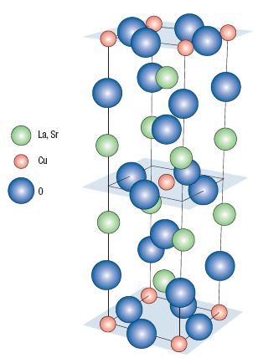




cf. Unconventional superconductivity
High partial wave pairing symmetries (e.g. p, d-wave …).
d-wave: high T_{c} cuprates.
$$\vec{k}$$
-
+
+
$$⊗$$
-
$$d_{x^{2}−y^{2}}$$
$$−\vec{k}$$
p-wave: ³He-A and B.
D. J. Van Harlingen, Rev. Mod. Phys. 67, 515 (1995); C. C. Tsuei et al., Rev. Mod. Phys. 72, 969 (2000).
Notes:
For superconductivity, we know in addition to the conventional s-wave pairing structure,
nature provides us many other types of non-conventional pairings.
They are high partial wave channel Cooper pairings.
The most important example is the d-wave pairing in the high Tc cuprate. If we move around the FS,
the pairing wavefunction function changes the sign exhibiting the structure of d-wave structure.
( Other unconventional Cooper pairing states have also been observed, for the
the p-wave pairing state was found in the He-3 and more recently in the
SrRuO4, systems. )
So, by analogy to the unconventional superconductivity, it is very natural
to further investigate the high partial wave generalization of FM, say p, d…
We will see SO coupling is dynamically generated in these unconventional magentic systems.
The phase transitions from normal FL to high partial wave FMs are just phase transitions
we want.

Slide 8

New states of matter: unconventional magnetism!
High partial-wave channel magnetism (e.g. p, d-wave…) .
Multi-polar spin distribution over the Fermi surface.
anisotropic p-wave state
isotropic p-wave state
spin flips the sign as $\vec{k}→−\vec{k}$.
spin-split state by J. E. Hirsch, PRB 41, 6820 (1990); PRB 41, 6828 (1990).
C. Wu and S. C. Zhang, PRL 93, 36403 (2004)
Notes:
For superconductivity, we know in addition to the conventional s-wave pairing structure,
nature provides us many other types of non-conventional pairings. The most important
example is the d-wave pairing in the high Tc cuprate. If we move around the FS,
the pairing wavefunction function changes the sign exhibiting the structure of d-wave structure.
( Other unconventional Cooper pairing states have also been observed, for the
the p-wave pairing state was found in the He-3 and more recently in the
SrRuO4, systems. )
So, by analogy to the unconventional superconductivity, it is very natural
to further investigate the high partial wave generalization of FM, say p, d…
We will see SO coupling is dynamically generated in these unconventional magentic systems.
The phase transitions from normal FL to high partial wave FMs are just phase transitions
we want.

Slide 9
2D d-wave α and β-phases
α-phase
β-phase: w=2
Time-reversal symmetry breaking and parity conserved → new SO coupling beyond relativity
C. Wu, K. Sun, E. Fradkin, and S. C. Zhang, PRB 75, 115103 (2007).

Slide 10
Introduction: electron spin liquid-crystal
unconventional superconductivity
unconventional magnetism
anisotropic electron liquid
Spin-orbit coupling
Notes:
Before we discuss interesting properties of the unconventional magnetic state,
let me present our research motivation from the experimental side. We begin
with the anisotropic state, and show it is an anisotropic electron liquid
state with spin degree of freedom.
So far we have presented the isotropic case, which provides a new
. And we will show its connection to the anisotropic electron liquid.

Slide 11
Anisotropy: liquid crystalline order
Classic liquid crystal.
Nematic phase: rotational anisotropic but translational invariant.
isotropic phase
nematic phase
Quantum version of liquid crystal: nematic electron liquid.
Fermi surface anisotropic distortions
S. Kivelson, et al, Nature 393, 550 (1998); V. Oganesyan, et al., PRB 64,195109 (2001).
Notes:
Spatial anisotropy is a very general phenomenon in condensed matter physics,
in particular in the liquid crystal physics. For example, the design of the
LCD of the laptop computer is based on this property of liquid crystal.
The nematic phase of liquid crystal is important, it is rotationally anisotropic
but still maintain translational invariance.
This classic liquid crystal has a quantum version in the electron liquid,
which can be called as nematic electron liquid. Typically, the Fermi
surface in such phase exhibit anisotropic distortions. In the simplest
Case in 2D, the circular FS is distorted into a ellipse.
These electron liquid phase exhibit in many cases of the strongly correlated systems.

Slide 12
Anisotropic unconventional magnetism:
(spin) liquid-crystal phases!
p-wave distortion of the Fermi surface.
Spin dipole moment in momentum space (not in coordinate space).
anisotropic p-wave magnetic phase
Both orbital and spin rotational symmetries are broken.
spin-split state by J. E. Hirsch, PRB 41, 6820 (1990); PRB 41, 6828 (1990).
V. Oganesyan, et al., PRB 64,195109 (2001). C. Wu et al., PRL 93, 36403 (2004); Varma et al., Phys. Rev. Lett. 96, 036405 (2006)
Notes:
Anisotropic unconventional magnetic state is an extension of the above nematic electron liquid
state by incorporating spin degree of freedom. For example, for the p-wave case, the Fermi surface distortion exhibit the p-wave symmetry.
Another popular example of Pomeranchuk instability is the F2s channel, where 2 means d-wave,
and s means density channel. In this channel, the original circular FS is distorted into
an ellipse. This can be considered as an electronic version of nematic liquid crystal,
which is dubbed as nematic FL by Oganesyan ….. The term of nematics is borrowed
from the liquid crystal physics, which means this phase breaks spatial rotational
symmetry, but maintain translational symmetry.

Slide 13
Spontaneous generation of spin-orbit coupling
unconventional superconductivity
unconventional magnetism
anisotropic electron liquid
Spin-orbit coupling
Notes:
So far we have presented the isotropic case, which provides a new
mechanism for the dynamic generation of SO coupling. Next we will show this isotropic phase has
an anisotropic cousin. And we will show its connection to the anisotropic electron liquid.

Slide 14
Unconventional magnetism: spontaneous generation of spin-orbit (SO) coupling!
Conventional wisdom:
A single-body effect from the Dirac equation
New mechanism (many-body collective effect):
Generate SO coupling through unconventional magnetic phase transitions.
Advantages: tunable SO coupling by varying temperatures;
new types of SO coupling impossible through relativity
Notes:
First, let us talk about the goal of our work: a new mechanism to generate spin orbit coupling.
Spin-orbit coupling plays an important role in condensed matter physics, in particular in
the emerging science of spintronics.
Conventionally, SO coupling originates from relativity correction to the band structure.
Furthermore, it is a single body effect, is not directly related to many body effects.
Since many-body physics is much richer than the single body physics,
it would be interesting to provide a deep connection between SO coupling
to many-body interactions. In the following, we will provide such a connection.
We will present a new mechanism to generate SO coupling
without relativity, but through phase transitions, in a similar way to ferromagnetism.
P.S. Understand what is the Dresselhaus term
3d) kx (ky^2-kz^2) sigma_x +ky (kz^2-kx^2) sigma_y +kz (kx^2-ky^2) sigma_z. Let project it to 2D plan,
<kz>=0→ (kx sigma_x – ky sigma_y).

Slide 15
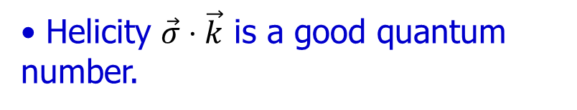
The isotropic p-wave magnetic phase
Helicity $\vec{σ}⋅\vec{k}$ is a good quantum number.
No net spin-moment; spin dipole moment in momentum space.
Isotropic phase with SO coupling.
C. Wu et al., PRL 93, 36403 (2004); C. Wu et al., PRB PRB.75, 115103 (2007). .
Notes:
Now let us look at the isotropic p-wave magnetic phase
These unconventional magnetism actually results from the Fermi surface instability of the Pomeranchuk type.
I will explain what is Pomeranchuk Instability later. Now let me just take the p-wave channel as an example.
This is the FS structure in the resultant phase. The dashed line is the original FS.
After the instability occurs, the FS splits to two parts, a large one and a small one.
On the large FS, electron spin is parallel to its momentum, when on the small FS,
electron spin is anti-parallel to its momentum. The p-wave feature is clear, if we
change k→ -k, spin also flips the sign.
Let us compare with s-wave FM: in both cases, FS splits. However, they have
Important difference. In the s-wave FM, spin polarization is along a fixed direction.
While in the p-wave case, spin varies with momentum. The spin is no longer conserved,
but helicity, the projection of spin on the momentum is still a good quantum number.
In the p-wave FM, the net spin moment is zero. It has spin dipole moment in
momentum space, not in the coordinate space.
In other words, such a phase is still isotropic, with a sigma dot k-like SO coupling.
The order parameter in this phase is just the SO coupling strength.

Slide 16



The subtle symmetry breaking pattern
SO coupling
ordered phase
disordered phase
$$F_{1}^{a}$$
is conserved, but are not separately conserved.
$$\vec{L},\vec{S}$$
Independent orbital and spin rotational symmetries.
$$\vec{J}=\vec{L}+\vec{S}$$
Leggett, Rev. Mod. Phys 47, 331 (1975)
Relative spin-orbit symmetry breaking.
Notes:
Now we can ask the question: what is the symmetry breaking pattern during the dynamic generation
of SO coupling? Let us sketch a phase diagram at zero temperature. The horizontal axis F1a
is the interaction parameters we will explain later. We assume the disordered phase to be the
usual Fermi liquid. This phase has two different independent rotational symmetries in the orbital and spin channels respectively.
The LHS is the ordered phase with SO coupling generated. It is still isotropic. If we rotate the spin and orbital
channels in the same way, the system is still invariant, i.e., total angular momentum is conserved.
However, if we do rotates in these two channels in a different way, the system is changed.
For example, if we fix momentum, and only rotate the spin, the system is changed.
In other word, the relative SO symmetry is broken. Since no superfluidity is involved,
this symmetry breaking occurs in the particle-hole channel.

Slide 17
Summary of the introduction
unconventional superconductivity
unconventional magnetism
electron liquid crystal with spin
spin-orbit coupling
Notes:
This is the summary of the interaction part. We have explained what is the
unconventional magnetism. It is an analogy of the USC in the context
of magnetism.
We have showed the Umagnetic phase can be classified into isotropic phase and
Anisotropic phase. The isotropic phase gives rise a new mechanism for dynamic
Generation of SO from many body interactions. The anisotropic
phase is an example of electron liquid crystal phase with spin.

Slide 18
Outline
Introduction.
Mechanism for unconventional magnetic phase transitions.
- Fermi surface instability of the Pomeranchuk type.
- Mean field phase structures.
- Collective modes and neutron spectroscopy.
Spin-orbit coupled Fermi liquid theory.
Possible directions of experimental realization and detection methods.
Notes:
This is the outline of the talk. First, there is a long introduction part.
I will explain our definition of unconventional magnetism, and show
it has deep connections to various important research directions
in condensed matter physics.
Then I will explain the mechanism for the unconventional magnetic
phases as a result of Fermi surface instability. At last, I will discuss
possible directions of experimental realization and detections.

Slide 19
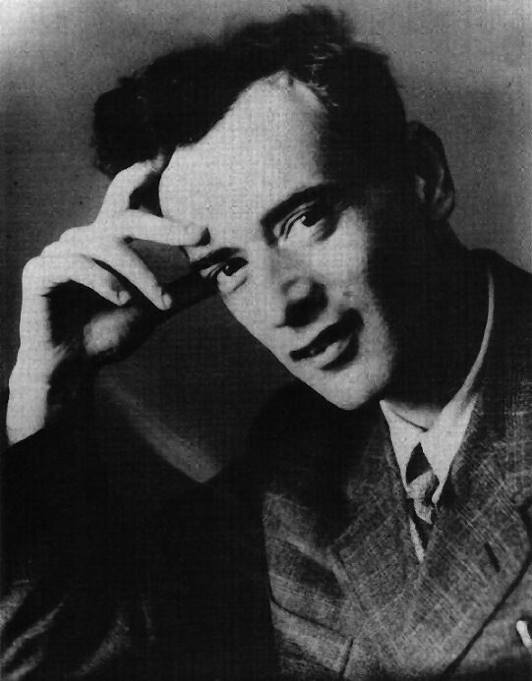
Landau Fermi liquid (FL) theory
The existence of Fermi surface.
Electrons close to Fermi surface are important.
Interaction functions:
density
spin
L. Landau
Landau parameter in the l-th partial wave channel:
Notes:
Having discussed the symmetry aspect of the transition, now let us move on to the general mechanism.
Most of our current understanding of the interacting electronic systems are based on the Landau Fermi
liquid theory. This theory was designed originally for the normal state of He-3, and also applies for
most metals. The essential point of this theory is that only electrons close to the Fermi surfaces are
Important.
FL liquid theory is characterized by the Landau interaction function, which describes the forward
scattering process for quasiparticles near the FS. It can be classified into the density channel
and spin channels. Traditionally, they are also denoted as symmetric, and asymmetric channels.
We can decompose Landau functions into different partial wave channels: s-wave, p-wave, ….
To make them dimensionless, we multiple the density of state.
Landau’s theory is completely determined by these parameters

Slide 20
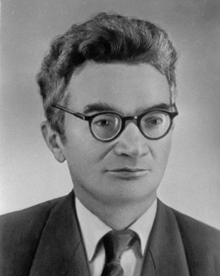
Pomeranchuk instability
Fermi surface: elastic membrane.
Stability:
Surface tension vanishes at:
I. Pomeranchuk
Ferromagnetism: the channel.
Nematic electron liquid: the channel.
Notes:
Pomeranchuk, Landau’s disciple, found that in order for the Fermi surface to be stable,
these Landau parameters can not be too negative. Otherwise, FS will be distorted.
He considered the Fermi surface as the elastic membrane in the momentum space, and perturb it
in each partial wave channels. As a result, there is a kinetic energy cost, and a change of the
interaction energy. The interaction energy is proportional to the Landau parameters.
As a result, the surface tension vanishes when this criterion is met.
FS distortion can occur in both density and spin channels. The most familiar example for
the Pomeranchuk instability is the Ferromagnetism as we discussed before.
It is an s-wave spin triplet channel instability. 0 means s-wave, a means spin triplet.
This is the celebrated Stoner criterion.

Slide 21
Unconventional magnetism: Pomeranchuk instability in the spin channel
An analogy to superfluid ³He-B (isotropic) and A (anisotropic) phases.
Notes:
Our unconventional magnetism actually arise from the PI in the spin channel.
We take the F1a channel as an example: 1 means p-wave, a means spin triplet.
This is the isotropic phase we have presented. Let me summarize it. It is an isotropic
phase, with SO coupling sigma dot k type. The FSs remains circular in this phase.
The p-wave distortion exhibit in the spin channel. We dub this phase as beta phase.
This phase has an anisotropic version dubbed alpha phase. In this phase, the p-wave
distortion exhibits in the orbit channel. The spin up FS is shifted to right, and spin
down FS is shifted to left. This phase was first studied by Jorge many years ago
in the context of transition metal Cr. Both phases are the high partial wave
channel generalization of ferromagnetism.
We use these terminology alpha and beta phase because they are p-h
channel analogy to the He-3 superfluid phases A and B.

Slide 22

cf. Superfluid ³He-B, A phases
p-wave triplet Cooper pairing.
$$Δ$$
B
A
³He-B (isotropic) phase.
³He-A (anisotropic) phase.
A. J. Leggett, Rev. Mod. Phys 47, 331 (1975)
Notes:
Now let me briefly introduce the He-3 superfluid phases. The cooper pairing structure of He-3
is p-wave spin triplet channel pairing. It has two different superfluid phases A and B phases.
Its B phase is particularly interesting. It is isotropic. It spin degree of freedom is described
by the so-called d-vector. In the B-phase, the d-vector is parallel to k. As a result, the gap
Function remains constant on the FS. The B-phase has an anisotropic counterpart called A-phase.
In the A-phase, the gap function is anisotropic. In 3D systems, the gap function
has nodes.

Slide 23
The order parameters: the 2D p-wave channel
: Spin currents flowing along x and y-directions, or spin-dipole moments in momentum space.
cf. Ferromagnetic order (s-wave):
Arbitrary partial wave channels: spin-multipole moments.
Notes:
For simplicity, we begin with the F1a channel. We first define the order parameters n1 and n2.
In this case, the order parameters are spin currents, or in other words, the spin
dipole moments in momentum space. Please note their angular form factor
cos in n1 and sin in n2. n1 is the spin current along x-orbital direction,
n2 is along y-spatial direction, each of them is a 3-vector representing the direction
in the spin space.
This is a generalization of the Ferromagnetic order parameter, which is the total spin moment.
This definition can be straight forwardly generalized into arbitrary partial wave channels by
Replacing the angular form factors.
It is straightforward to generalize this definition to arbitrary channel by replacing the
corresponding angular form factors. The physical meaning of the order parameter is
the multipole spin component over the FS. Here are the symmetry constrains of the theory.
The theory should satisfy rotational symmetry in both spin and orbital space, as well as
parity and time reversal.

Slide 24
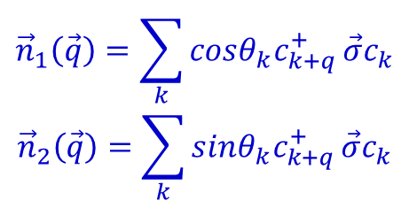
Mean field theory and Ginzburg-Landau free energy
The simplest non-s-wave exchange interaction:
$${\vec{n}}_{1}\left(\vec{q}\right)=\sum_{k}{cosθ_{k}c_{k+q}^{+}}\vec{σ}c_{k}$$
$${\vec{n}}_{2}\left(\vec{q}\right)=\sum_{k}{sinθ_{k}c_{k+q}^{+}}\vec{σ}c_{k}$$
Symmetry constraints: rotation (spin, orbital), parity, time-reversal.
instability!
Notes:
This is the our inter-action Hamiltonian, which represents the spin-current spin-current interactions.
This interaction sounds a little bit unrealistic, but actually quite reasonable, because it
is the simplest non-s-wave exchange interaction.
Following the standard mean field procedure, we perform the mean field decoupling, and arrive
at the mean field Hamiltonian. In order to determine the possible phase structure, we construct the
GL free energy up to the quartic level, which satisfies all the symmetry constraint.
The coefficients can be calculated. The coefficient of the
quardratic term r is important. If r goes negative, instability occurs. We have two quartic terms.
The sign of the v2 is also important. Whether it is positive or negative gives two different
resultant phases.
.
If v2 is positive, then it favors a colinear pattern of n1 and n2, giving rise to the alpha phase.
If v2 is negative, it favors an orthogonal configuration of n1 and n2, giving rise the beta phase.
*************************************************************************
Q: For superconducting, GL equation is valid close to Tc.
Here why it is valid at zero temperature?

Slide 25
β and α-phases (p-wave)
Notes:
Now we are ready to present the resultant phases in the spin channel Pomeranchuk instabilities.
We still take the F1a channel as an example: 1 means p-wave, a means spin triplet.
This is the isotropic phase we have presented. Let me summarize it. It is an isotropic
phase, with SO coupling sigma dot k type. The FSs remains circular in this phase.
The p-wave distortion exhibit in the spin channel. We dub this phase as beta phase.
This phase has an anisotropic version dubbed alpha phase. In this phase, the p-wave
distortion exhibits in the orbit channel. The spin up FS is shifted to right, and spin
down FS is shifted to left. This phase was first studied by Jorge many years ago
in the context of transition metal Cr. Both phases are the high partial wave
channel generalization of ferromagnetism.
We use these terminology alpha and beta phase because they are p-h
channel analogy to the He-3 superfluid phases A and B.

Slide 26
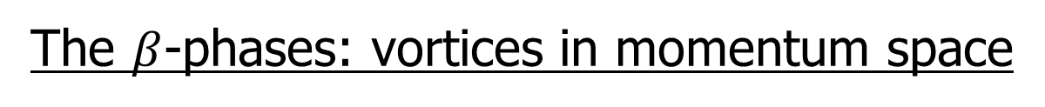
The $β$-phases: vortices in momentum space
A
B
C
W=1
W=1
W=-1
Rashba
Dresselhaus
Perform global spin rotations, A→ B→ C.
L. Fu’s(PRL2015): gyro ferroelectric muti-polar
Notes:
Now let us check the beta-phases. They exhibit vortex structure in the momentum space.
By choosing different order parameter configuration, we arrive a number of SO couplings.
This is the sigma . k type SO coupling, it’s a vortex in the momentum space with winding number 1.
If we perform a global spin rotation around the z-axis 90 degree, n1→ n2, n2→-n1, we arrive at the Rashba coupling.
If we rotation around x-axis 180 degree, n1→n1, n2→-n2 we arrive at (2D) Dresselhaus coupling, and the
winding number changes from 1 to -1.
The remaining symmetry in these phases are SO(2) generated by a suitable defined total angular momentum.

Slide 27
2D d-wave α and β-phases
α-phase
β-phase: w=2
β-phase: w=-2
Time-reversal symmetry breaking and parity conserved → new SO coupling beyond relativity

Slide 28
The α-phases: orbital & spin channel Goldstone (GS) modes
Orbital channel GS mode: FS oscillations (intra-band transition).
Anisotropic overdamping: The mode is maximally overdamped for q along the x-axis, and underdamped along the y-axis (l=1).
Spin channel GS mode: “spin dipole” precession (spin flip transition).
Nearly isotropic, underdamped and linear dispersions at small q.
Notes:
We use the RPA approximation to calculate the fluctuation kernel around the mean field saddle point.
Let us begin with the alpha-phases. The alpha phases break rotational symmetries both in the orbital
and spin channels, so the GS modes can be classified into density channel modes and spin
channel modes.
The density channel GS mode is the just oscillation of the distorted FS.
We assume the FS distortion along the x-direction with spin along z-direction.
Then this GS mode is overdamped because of the Landau damping.
This damping effect is anisotropic, depending on the propagation directions.
For l=1, this mode is maximally damped along the x-direction.
As q varies from the x-direction, the damping becomes smaller,
becomes underdamped if q is along the y-direction.

Slide 29
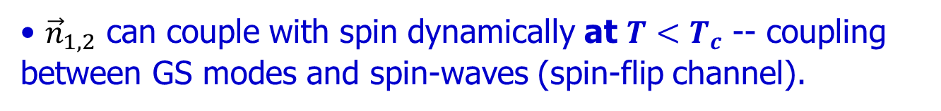
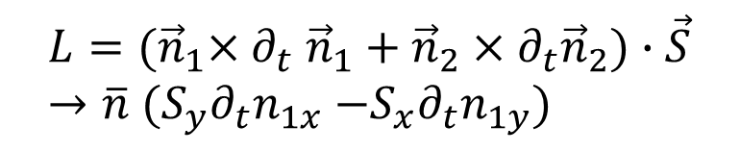
The α-phases: neutron spectra
No elastic Bragg peaks.
${\vec{n}}_{1,2}$ can couple with spin dynamically at ${T<T}_{c}$ -- coupling between GS modes and spin-waves (spin-flip channel).
$$L={(\vec{n}}_{1}{×∂}_{t}{\vec{n}}_{1}+{\vec{n}}_{2}×∂_{t}{\vec{n}}_{2})∙\vec{S}→\overline{n}{ (S_{y}∂}_{t}n_{1x}{ −S_{x}∂}_{t}n_{1y})$$
In-elastic: resonance peaks develop at T<T_{c}.
Notes:
Spin channel GS modes do not couple to neutron moments directly. However, they do carry spin quantum
numbers and thus couple to spin wave modes.
In the ordered alpha phase, it induces a resonant part in the transverse spin wave-excitations,
which can be detected in the non-elastic neutron scattering experiments.
Such a resonance peak only exhibit in the ordered phase, and vanishes in the disordered phase.

Slide 30
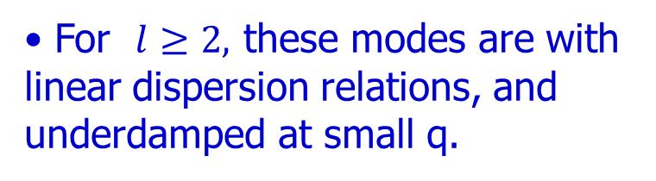
The β-phases: GS modes
3 branches of relative spin-orbit modes.
For $l≥2,$ these modes are with linear dispersion relations, and underdamped at small q.
Inelastic neutron spectra: GS modes also couple to spin-waves, and induce resonance peaks in both spin-flip and non-flip channels.
Particle-hole continuum
Notes:
Let us study the Goldstones in the beta phase. They are relative spin-orbit rotations.
For example, we fix the momentum unchanged, and only rotate the spin.
We have three different ways to rotate it, there are three GS modes.
Furthermore, we can classify them using the projection of angular momentum along z-aixs.
The z-axis is chosen along the direction of the GS modes proporgate.
There is one longitudinal and two transverse modes. The two transverse modes have
The opposite helicity.

Slide 31
Outline
Introduction.
Mechanism for unconventional magnetic phase transitions.
- Fermi surface instability of the Pomeranchuk type.
- Mean field phase structures.
- Collective modes and neutron spectroscopy.
Spin-orbit coupled (inversion-invariant) Fermi liquid theory.
Possible directions of experimental realization and detection methods.
Notes:
This is the outline of the talk. First, there is a long introduction part.
I will explain our definition of unconventional magnetism, and show
it has deep connections to various important research directions
in condensed matter physics.
Then I will explain the mechanism for the unconventional magnetic
phases as a result of Fermi surface instability. At last, I will discuss
possible directions of experimental realization and detections.

Slide 32
Cd2Re2O7
Inversion symmetry breaking is observed via 2nd harmonic generation below the transition temperature.
J.W. Harter, et al. Science 356, 295 (2017)
Notes:
Next let me summarize several possible direction for searching such phases.
First, the normal state of He-3. We know the ferromagnetic fluctuations in He-3 are very strong.
The F1a is negative and reasonably large, but still not large enough to pass the critical values.
Nevertheless, we can expect reasonably strong fluctuations in the F1a channel.
Another relevant system in the heavy fermion compound URu2Si2. A mysterious phase transition takes place
At 17 K. The specific heat exhibit a large anomaly. However, after 20 years research effort, the nature
of this transition is still unknown. One interesting property of this phase transitions is that the
non-linear magnetic susceptibility also has a jump at the transition.
Recently, Varma proposed a helicity order as a candidate for the hidden order behavior, which is the alpha phase
in our language. They did the calculation for thermodynamic quantities, and fit the experiment reasonably well.
However, we need to bear in mind that this hidden order behavior is still highly debating.
For example, P. Coleman has another phase of incommensurate current order,
which breaks TR symmetry and results in incommensurate B field inside the sample.
There is an important experiment about the NMR line width broadening below Tc,
which scales with amplitude of the order parameter below Tc. It means that a random
magnetic field appears below Tc, and it should result from the order parameter.
In Varma’s senario, the random magnetic field is explain as the impurity induced spin moment.
In Coleman’ phase, it naturally arises from the orbit current.
My personal opinion is that Varma’s phase or the alpha phase obey TR symmetry

Slide 33


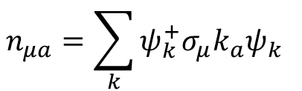


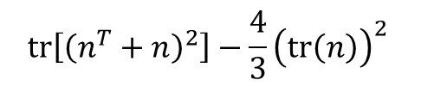





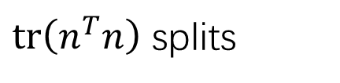
Spin-orbit symmetry
$$n_{μa}=\sum_{k}{ψ_{k}^{+}σ_{μ}k_{a}ψ_{k} }$$
$${SO}_{L}\left(3\right)⨂{SO}_{S}\left(3\right)→SO_{L+S}(3)$$
$tr\left(n^{T}n\right)$ splits
$${\left(tr\left(n\right)\right)}^{2}$$
$${tr\left[{\left(n^{T}+n\right)}^{2}\right]−\frac{4}{3}{\left(tr\left(n\right)\right)}^{2}}^{ }$$
$${tr[(n^{T}−n)}^{2}]$$
$${\vec{σ}⋅\vec{k}}^{ }$$
$${\left(\vec{σ}×\vec{k}\right)⋅\hat{z}}^{ }$$
$$σ_{x}^{ }k_{x}−σ_{y}k_{y}$$
scalar $(J=0)$
Anti-sym $(J=1)$
symmtric $(J=2)$

Slide 34

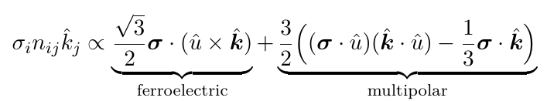








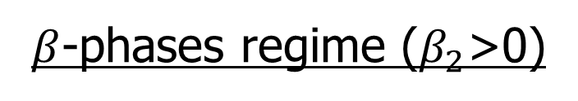
$β$-phases regime ($β_{2}$>0)
$$\frac{2}{3}π−phase$$
$$n∈SO\left(3\right)$$
$$Tr\left(n\right)=1+2 cos θ=0$$
$$β_{2}Tr{(n^{T}n)}^{2}$$
Spin-$↑$
Spin-$↓$
$$n∝I$$
$$λ_{0}{(Tr n)}^{2}$$

Slide 35
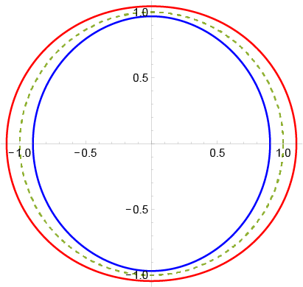
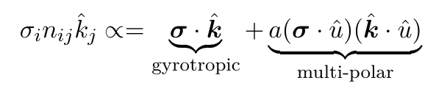
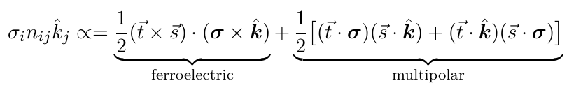




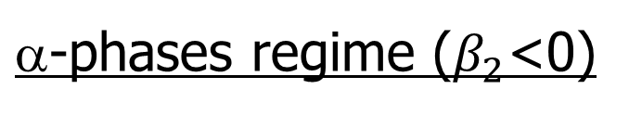



$\text{a}$-phases regime ($β_{2}$<0)
$$β_{2}Tr{(n^{T}n)}^{2}$$
$$λ_{0}{(Tr n)}^{2}$$
$$n∝I$$
Spin-$↑$
Spin-$↓$
$$\vec{s}$$
$$\vec{t}$$
$$n=\vec{t}⨂\vec{s}, \vec{t}⊥\vec{s}$$

Slide 36
Outline
Introduction.
Mechanism for unconventional magnetic phase transitions.
- Fermi surface instability of the Pomeranchuk type.
- Mean field phase structures.
- Collective modes and neutron spectroscopy.
Spin-orbit coupled Fermi liquid theory – magnetic dipolar interaction.
Possible directions of experimental realization and detection methods.
Notes:
This is the outline of the talk. First, there is a long introduction part.
I will explain our definition of unconventional magnetism, and show
it has deep connections to various important research directions
in condensed matter physics.
Then I will explain the mechanism for the unconventional magnetic
phases as a result of Fermi surface instability. At last, I will discuss
possible directions of experimental realization and detections.

Slide 37
A natural generalization of ferromagnetism
The driving force is still exchange interactions, but in non-s-wave channels.
 | s-wave | p-wave | d-wave
SC/SF | Hg, 1911 | ³He, 1972 | high T_{c}, 1986
magnetism | Fe, ancient time | ? | ?
Optimistically, unconventional magnets are probably not rare.
cf. Antiferromagnetic materials are actually very common in transition metal oxides. But they were not well-studied until neutron-scattering spectroscopy was available.
Notes:
So far we are not aware of conclusive evidence for the existence of the unconventional magnets.
However, they are natural generalizations of ferromagnetism. The driving force is still the exchange
interaction, but in the non-s-wave channel.
Taking into account the great discoveries of the unconventional superconductivity and superfluidity
in He-3 and high Tc cuperate, we are optimistic to expect that these phases could
be found in the near future.
Even more optimistically, these unconventional magnets are probably not so rare.
Let look at the research history on the antiferromagetism. Now we know antiferromagetic materials
are actually very common in transition metal oxide. They are even more common then ferromagnetic
Materials. Although ferromagnetism has been know for thousands of years, the antiferromagnetism
the research only began 7 or 8 decades ago, after the available experimental detection method
of neutron scattering. So perhaps, we need to find these unconventional magnets.

Slide 38
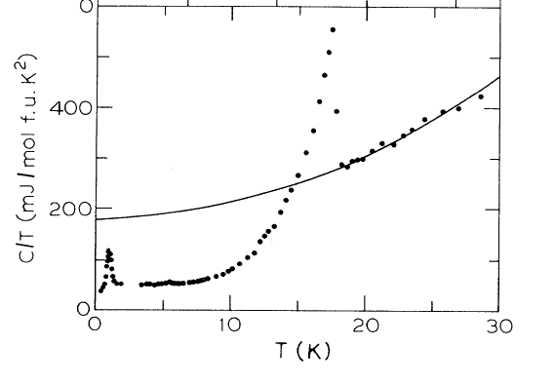
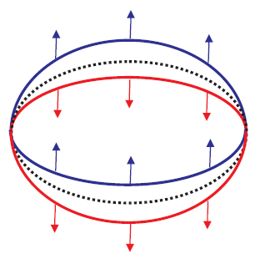
URu₂Si₂ : Hidden order below 17.5K
T. T. M. Palstra et al., PRL 55, 2727 (1985); M. B. Maple et al, PRL 56, 185 (1986)
helicity order (the p-wave α-phase);
U
Ru
Si
Varma et al., Phys. Rev Lett. 96, 036405 (2006)
Notes:
Next let me summarize several possible direction for searching such phases.
First, the normal state of He-3. We know the ferromagnetic fluctuations in He-3 are very strong.
The F1a is negative and reasonably large, but still not large enough to pass the critical values.
Nevertheless, we can expect reasonably strong fluctuations in the F1a channel.
Another relevant system in the heavy fermion compound URu2Si2. A mysterious phase transition takes place
At 17 K. The specific heat exhibit a large anomaly. However, after 20 years research effort, the nature
of this transition is still unknown. One interesting property of this phase transitions is that the
non-linear magnetic susceptibility also has a jump at the transition.
Recently, Varma proposed a helicity order as a candidate for the hidden order behavior, which is the alpha phase
in our language. They did the calculation for thermodynamic quantities, and fit the experiment reasonably well.
However, we need to bear in mind that this hidden order behavior is still highly debating.
For example, P. Coleman has another phase of incommensurate current order,
which breaks TR symmetry and results in incommensurate B field inside the sample.
There is an important experiment about the NMR line width broadening below Tc,
which scales with amplitude of the order parameter below Tc. It means that a random
magnetic field appears below Tc, and it should result from the order parameter.
In Varma’s senario, the random magnetic field is explain as the impurity induced spin moment.
In Coleman’ phase, it naturally arises from the orbit current.
My personal opinion is that Varma’s phase or the alpha phase obey TR symmetry

Slide 39
Detection (I): ARPES
Angular Resolved Photo Emission Spectroscopy (ARPES).
ARPES in spin-orbit coupling systems ( Bi/Ag surface), Ast et al., cond-mat/0509509.
band-splitting for two spin configurations.
α and β-phases (dynamically generated spin-orbit coupling):
The band-splitting is proportional to order parameter, thus is temperature dependent.
C. Wu, K. Sun, E. Fradkin, and S. C. Zhang, PRB 75, 115103 (2007).
Notes:
Now let us assume these phases exist, then experimental detection methods should be many.
For example, the ARPES can be used to detect the band splitting.
In fact, such experiment has been performed in the system with relativistic SO coupling.
For example, this figure shows the detection of the relativistic SO coupling in the
Bi surface state. This is the experimentally measured band dispersions.
The double peak structure represent the spin-orbit band splitting.
In our dynamically generated SO coupling, we expect to observe the band splitting occurs
at the transition temperatures and enlarged as the T is further lowered.

Slide 40


Detection (II): neutron scattering and transport
Elastic neutron scattering: no Bragg peaks; Inelastic neutron scattering: resonance peaks below T_{c}.
Transport properties.
β-phases: Temperate dependent beat pattern in the Shubnikov - de Hass magneto-oscillations of ρ(B).
N. S. Averkiev et al., Solid State Comm. 133, 543 (2004).
Notes:
If such phase exists, the experimental detection should be straightforward.
In principle, the ARPES can be used to detect the Fermi surface spilitting.
Neutron scattering experiment: there is no static Bragg peaks. But in the inelastic
Neutron scattering experiment,
The transport properties can be used to detect the enhancement of the anomalous Hall
Coefficent at Tc, where the SO coupling is generated.

Slide 41
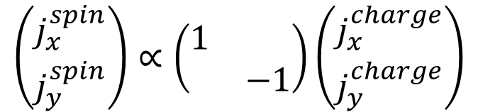
Detection (III): transport properties
Spin current induced from charge current (d-wave). Their directions are symmetric about the x-axis.
$$\left(\begin{aligned}j_{x}^{spin} \\ j_{y}^{spin}\end{aligned}\right)∝\left(\begin{matrix}1 & \\ & −1\end{matrix}\right)\left(\begin{aligned}j_{x}^{charge} \\ j_{y}^{charge}\end{aligned}\right)$$
C. Wu, K. Sun, E. Fradkin, and S. C. Zhang, PRB 75, 115103 (2007).
Notes:
Since all these phases exhibit certain type of SO coupling, we can also think about detection along this direction.

Slide 42
Summary
unconventional superconductivity
α-phase
β-phase
unconventional magnetism
electron liquid crystal with spin
spin-orbit coupling
Notes:
We are quite confident about the experiment discovery of these exotic phases in the near future.

Slide 43
Nematic electron liquid in Sr₃Ru₂O₇ at high B fields
Quasi-2D system; resistivity anisotropy at 7~8 Tesla.
Fermi surface nematic distortions.
I
I
S. A. Grigera et al., Science 306 1154, (2004). R. A. Borzi et al.. Science express (2006).
Notes:
Another interesting system is the bilayer Strongthum Ruthenate.
This material develops a metamagnetic phase transition in the
large external magnetic field around 8 T. In the phase, the transport
Measurement is perform exhibiting large anisotropy. The field is tilted
Along the a-axis, the resistivity is measured along both a and b-axis.
The results show significant difference.
This anisotropy can be conveniently explained as the result of the nematic
FS distortions. The distortion pattern should be pinned by the in-plane
component of the magnetic field.
Because there is already a large external magnetic field, the system is partially polarized.
This instability is not purely in density or in spin channels. It is a mixture of
the density and spin channel instabilities.

Slide 44
Band hybridization enhanced Landau interaction in high partial-wave channels
A heuristic argument: a hybridized band Bloch wavefunction with internal orbital configuration as
The Landau interaction acquires a d-wave angular form factor as.
Even V(p1-p2) is dominated by the s-wave component, the angular form factor shifts a significant part of the spectra weight into the d-wave channel.

